Slide 2
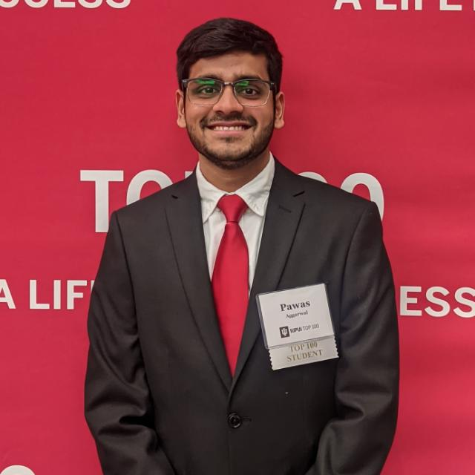
PAWAS
AGGARWAL
School of Science
Computer Science
Minor(s): Mathematics
HIGHLIGHT:
Received the Top 100 student award for 2022, and was an International Peer Mentor at the Office of International Affairs – which was the “most fun” program he got to be a part of.
HOMETOWN: NEW DELHI, INDIA

Slide 3
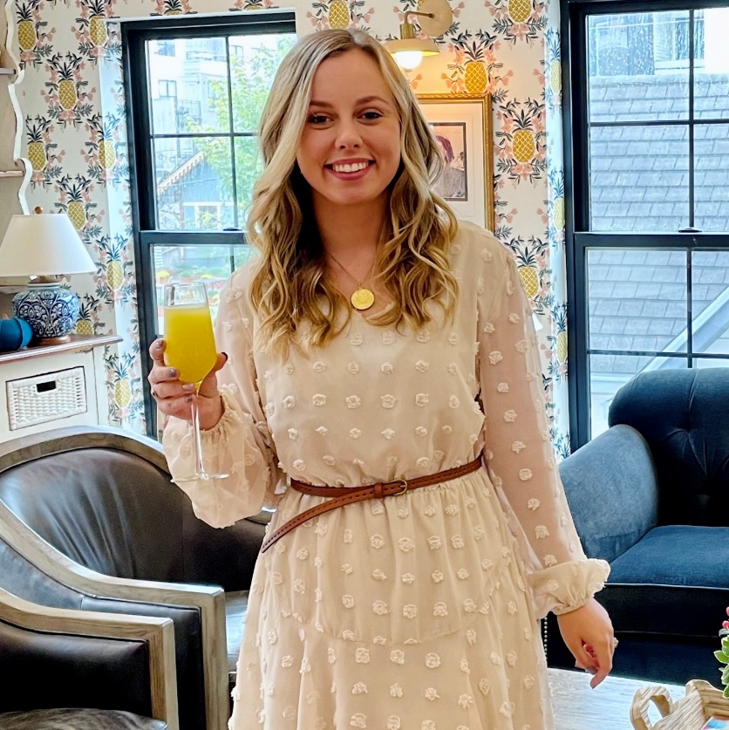
GRACE
ALLEN
Kelley School of Business
Management
HIGHLIGHT:
Successfully balancing school work, professional work, and getting married. Now, Grace gets to graduate with her husband by her side.
HOMETOWN: ZIONSVILLE, IN

Slide 4
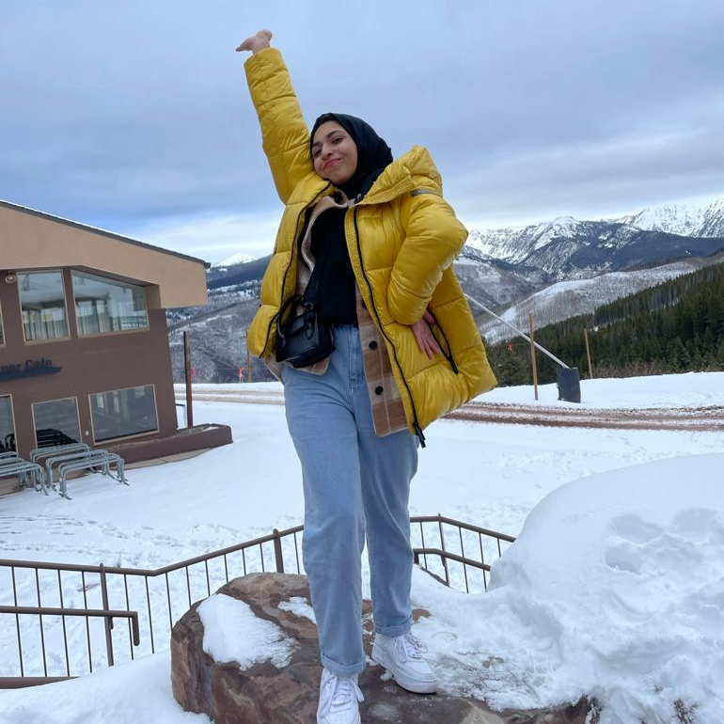
ZAHRA
AL ZARA
School of Informatics & Computing
Health Information Management
HIGHLIGHT:
Being an Honor Student, receiving great opportunities for work experience, and meeting valuable instructors and students.
HOMETOWN: SAUDI ARABIA

Slide 5
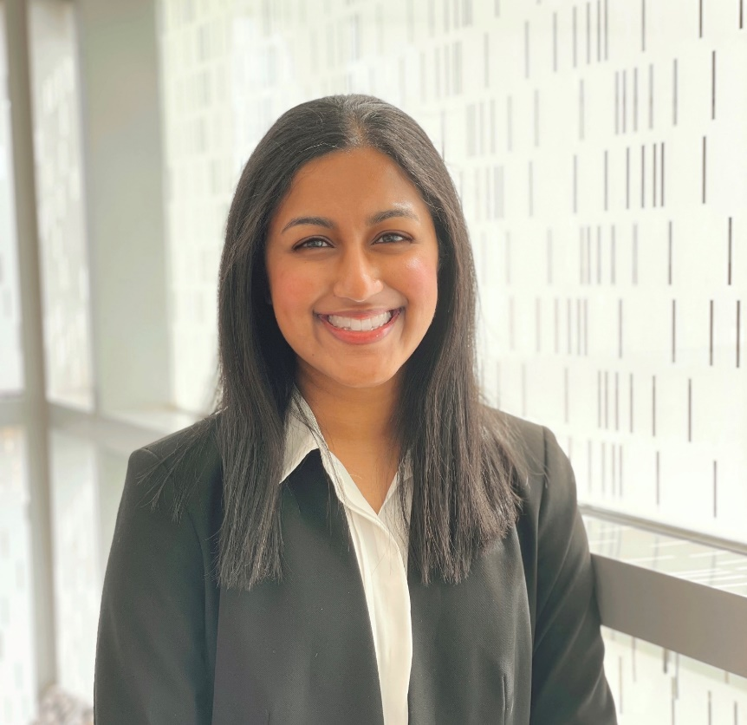
AIYSHA
AMJAD
School of Science
Biology, Neuroscience
Minor(s): Psychology
HIGHLIGHT:
Serving as Executive Director of the IUPUI Regatta, being able to take electives at the Herron School of Art (such as Intro to Painting and Wheel Throwing), and being part of the Pre-Dental Club at IUPUI.
HOMETOWN: INDIANAPOLIS, IN

Slide 6
JULIE
AMSTUTZ
School of Science
Neuroscience
Minor(s): Mathematical Sciences, Biology
HIGHLIGHT:
Was a first-year seminar mentor, a learning assistant for Intro to Psychology for four semesters, and was a volunteer at Community Hospital, as well as part of their HELP program.
HOMETOWN: ARNOLD, MO

Slide 7
ROHAN
ANGADI
School of Liberal Arts
Quantitative Economics
Minor(s): Data Analytics
HIGHLIGHT:
Joining the International Peer Mentoring Program as a mentor, and winning IUPUI Top 100.
HOMETOWN: BANGALORE, INDIA

Slide 8
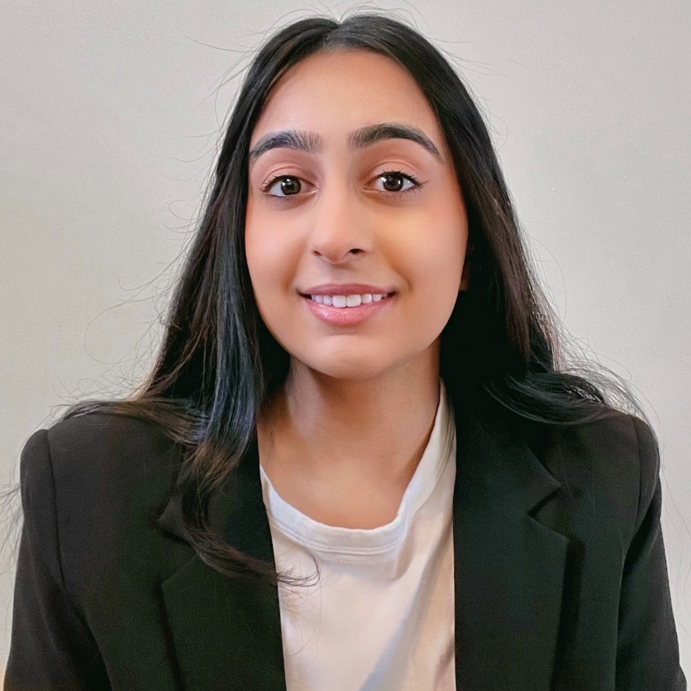
IQRA
ASAD
School of Science
Biology
Minor(s): Business
HIGHLIGHT:
Receiving Top 100, creating the Pakistani Student Association with her friends, and getting published through IU School of Medicine.
HOMETOWN: CARMEL, IN

Slide 9
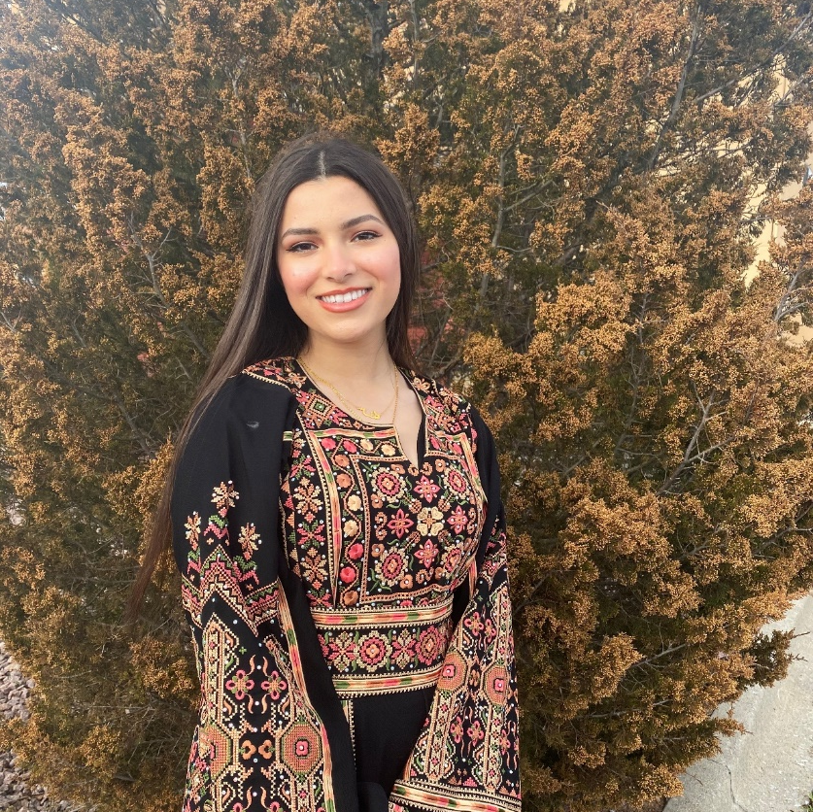
DANA
AWAD
School of Science
Chemistry
Minor(s): Biology
HIGHLIGHT:
Being a TA, Dana was able to meet many amazing and inspiring people, teach others about a subject she is passionate about, and allowed her to believe in herself. She also was involved in the VIDA club where she met many people and received various opportunities.
HOMETOWN: FISHERS, IN

Slide 10
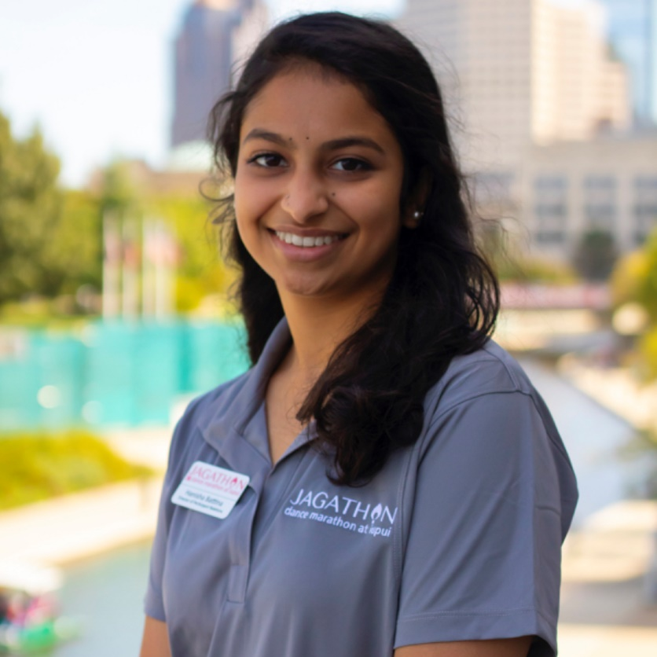
HANISHA
BATTINA
School of Science
Biology, Neuroscience
Minor(s): Chemistry, Health Psychology
HIGHLIGHT:
Receiving various awards throughout her undergrad career, being an IUPUI Top 100 Student in 2021 and 2022, presenting her research at five different conferences and being listed as a co-author on three different publications, and serving as the Director of Participant Relations for Jagathon 2022.
HOMETOWN: CARMEL, IN

Slide 11
TANNER
BLANKENSHIP
School of Engineering & Technology
Biomedical Engineering
Minor(s): Mathematics
HIGHLIGHT:
Working for ALDPES as a board member, being a member and holding a position in the Honors Adventure Club, and the capstone presentation of his prototype medical device.
HOMETOWN: FORT WAYNE, IN

Slide 12
RENAE
BLEVINS
School of Science
Neuroscience
Minor(s): Biology
HIGHLIGHT:
Competing on the IUPUI Women's Soccer team, participating as a research assistant at IU Medicine through UROP, being a TA for Intro to Psychology and helping students succeed in the course.
HOMETOWN: PLAINFIELD, IL

Slide 13
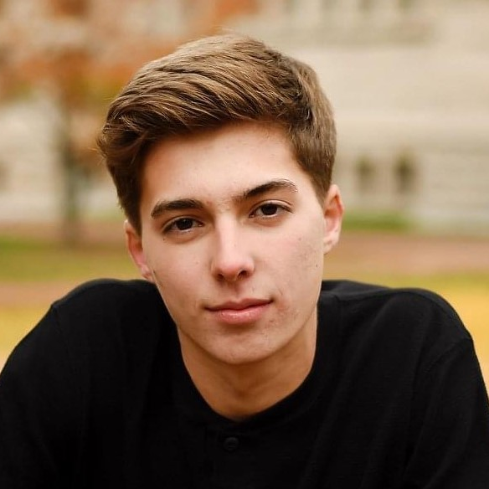
NATHAN
BOLIN
School of Science
Environmental Science
Minor(s): Mathematics
HIGHLIGHT:
Leading fellow students through the Chemistry PLTL program, building relationships with fellow interns in the Office of Sustainability, and gaining valuable research experience through the MURI program during his freshman year.
HOMETOWN: BLOOMINGTON, IN

Slide 14
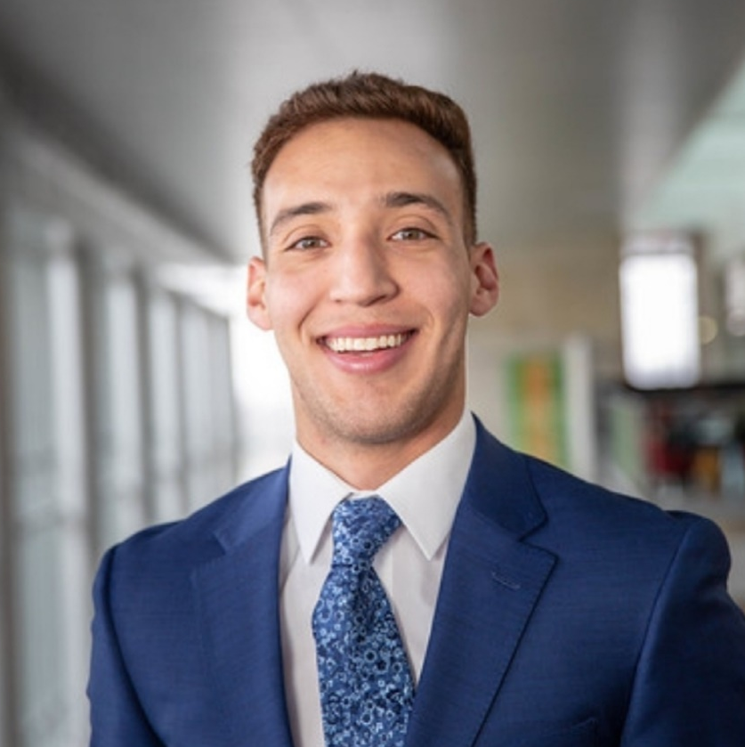
FERNANDO
BORGES
Kelley School of Business
Finance, Accounting, International Studies
Minor(s): Economics
HIGHLIGHT:
Being a student-athlete at IUPUI, completing the Honors I-Core, and participating in IUPUI’s Regatta with his friends.
HOMETOWN: KANSAS CITY, MO

Slide 15
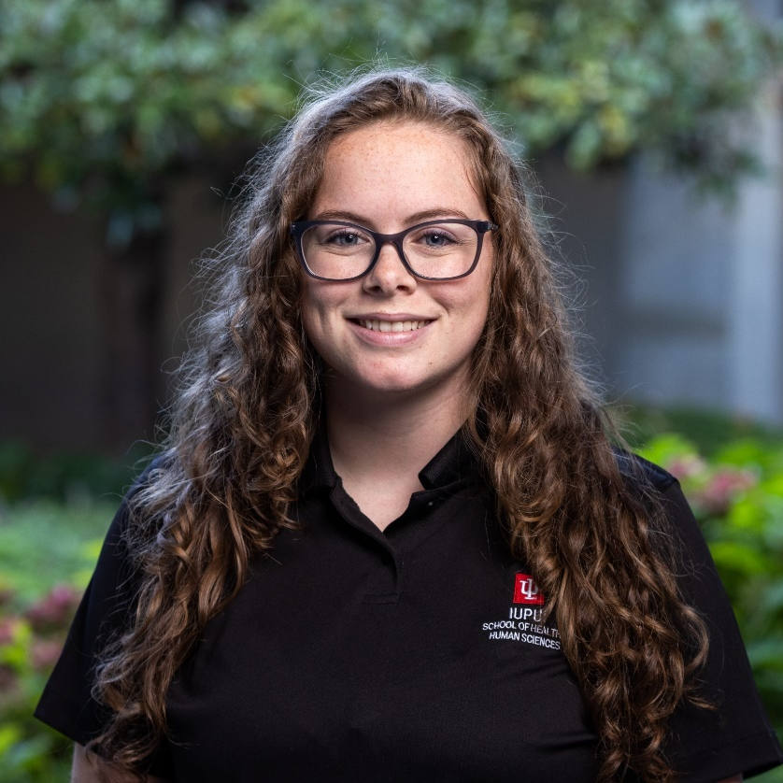
KATELYN
BROWN
School of Health & Human Sciences
Exercise Science
HIGHLIGHT:
The time Katelyn spent with the Motor Activity Clinic at IUPUI helped to solidify the thought of her becoming an Occupational Therapist. From her time at IUPUI, she has learned many valuable lessons, met people she can now consider friends, and had amazing professors that she could always confide in and go to for help.
HOMETOWN: MOORES HILL, IN

Slide 16
TAYLOR
BROWN
School of Science
Biology
Minor(s): Epidemiology
HIGHLIGHT:
For her capstone, Taylor helped develop a fast and cheap assay to identify COVID-19 variants as the pandemic was ongoing. She was also an LHSI intern, an Organic Chemistry II Lab TA, and a PLTL C106 recitation leader. At IUPUI, Taylor made lifelong friends and discovered her passion for teaching.
HOMETOWN: RICHMOND, IN

Slide 17
JOSEPH
BUSTAMANTE
School of Engineering & Technology
Biomedical Engineering
Minor(s): Mathematics
HIGHLIGHT:
Being accepted into the LHSI program for an internship, receiving the Dean's List numerous times, and receiving the PLTL award.
HOMETOWN: DEARBORN, MI

Slide 18
JESSICA
CANTIN
School of Public & Environmental Affairs
Criminal Justice
Minor(s): Policy Studies
HIGHLIGHT:
Being a student employee at the Bepko Learning Center, O'Neill School of Public and Environmental Affairs, and the Office of Student Employment; being in Phi Mu Fraternity and serving in many leadership roles (Academic Excellence Executive Officer, Service Chairwoman, and Honor Committee Member); and, graduating with distinction from the O'Neill School of Public and Environmental Affairs and from the IUPUI Honors College.
HOMETOWN: FISHERS, IN

Slide 19
CHRIS
CARDOZA
School of Science
Physics
Minor(s): Computer Science, Math
HIGHLIGHT:
Being the 2022 student commencement speaker, being a member and a president of Students for the Exploration and Development of Space at IUPUI, and getting a chance to visit Cornell University for Model United Nations.
HOMETOWN: MANGALORE, INDIA

Slide 20
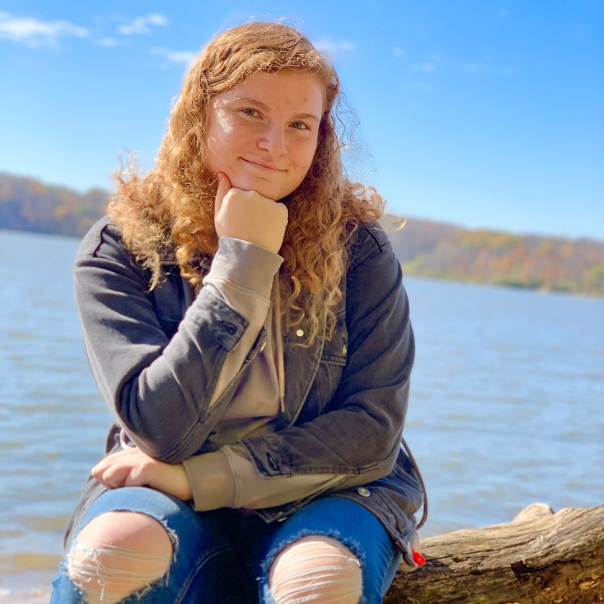
LAUREN
CARPENTER
School of Liberal Arts
Chinese Language & Culture
Minor(s): Linguistics
HIGHLIGHT:
Had the opportunity to make lasting change in the School of Liberal Arts for students and student organizations as a Student Council exec member; worked with the other Chinese Culture Club executive members to organize huge celebrations for students; and, was able to explore her major more by working closely with her professors because of her work through the Honors College.
HOMETOWN: FORT WAYNE, IN

Slide 21
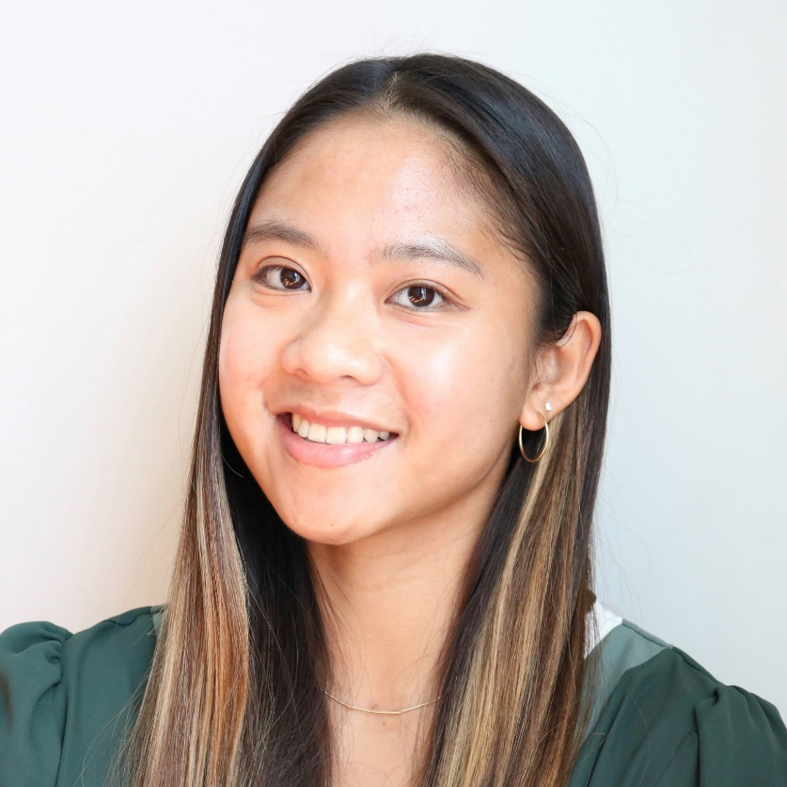
AUDREY
CHESHIRE
School of Engineering & Technology
Electrical Engineering
Minor(s): Technical Communication
HIGHLIGHT:
Chosen to be a Navy Engineering, Innovation, and Leadership (NEIL) Scholar; and, was awarded the DoD SMART Scholarship.
HOMETOWN: BLOOMINGTON, IN

Slide 22
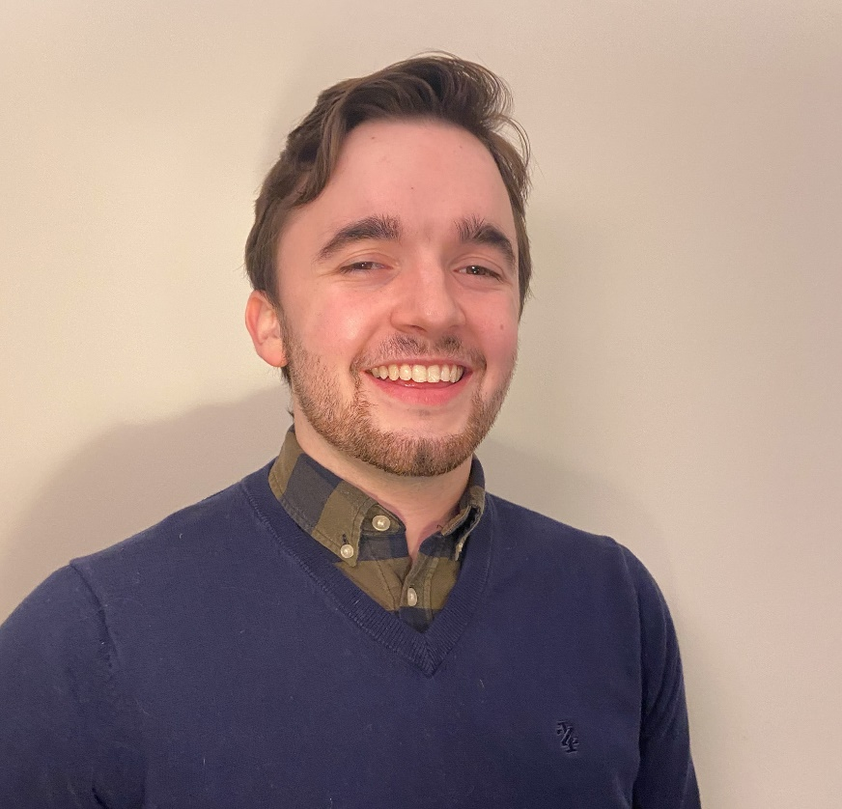
MASON
CHRISTIE
School of Science
Psychology
HIGHLIGHT:
Mason met his wife at IUPUI during orientation, and later proposed to her on campus. He also received the Jesse and Beulah Cox Scholarship, and was part of the Life and Health Science Internship where he created a page for clinicians that gave them information on various faiths.
HOMETOWN: STILESVILLE, IN

Slide 23
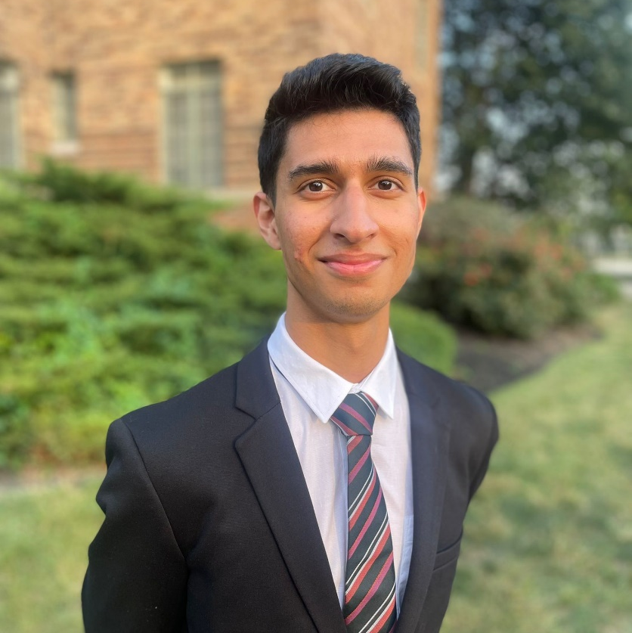
VARDHAN
CHULANI
Kelley School of Business
Finance, International Studies, Quantitative Economics
Minor(s): Fundamentals of Data Analytics
HIGHLIGHT:
Being a two-time recipient of IUPUI’s Top 100 Award, studying abroad at the London School of Economics, and publishing a paper for Undergraduate Economics Reviews – a finance and economics journal.
HOMETOWN: INDIANAPOLIS, IN

Slide 24
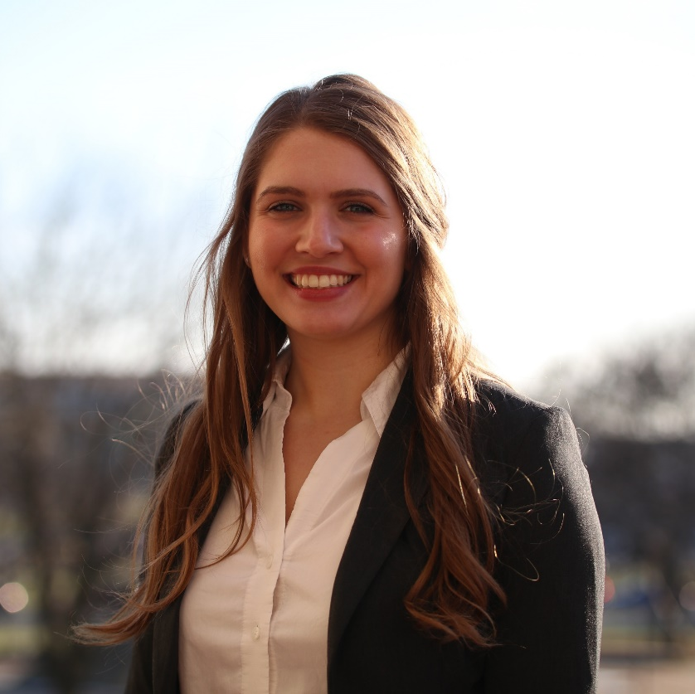
ANA
DANNER
School of Science
Biology, Neuroscience, Psychology
Minor(s): Chemistry, Spanish, Liberal Arts Perspectives on Culture & Health
HIGHLIGHT:
Mentored fellow IUPUI students as an Academic Mentor for K101 Biology, Honors College Peer Mentor, and First-Year Seminar Mentor; studied abroad in Iceland; and, was named one of IUPUI's Top 10 students in 2021 and 2022.
HOMETOWN: INDIANAPOLIS, IN

Slide 25
RACHEL
DOYLE
School of Science
Biology
Minor(s): Health Psychology
HIGHLIGHT:
Made either the Scholar's List or Dean's List each semester at IUPUI, participated in IUPUI's a cappella group, and is the Vice President of the group. Rachel performed with her group in several events including ICCA, Regatta, and Jagathon.
HOMETOWN: INDIANAPOLIS, IN

Slide 26
MARKO
DRAGISIC
School of Science
Biology
Minor(s): Chemistry
HIGHLIGHT:
Working in the Li Lab at the School of Science and the Kacena Lab at IU School of Medicine.
Also, graduating!
HOMETOWN: SCHERERVILLE, IN

Slide 27
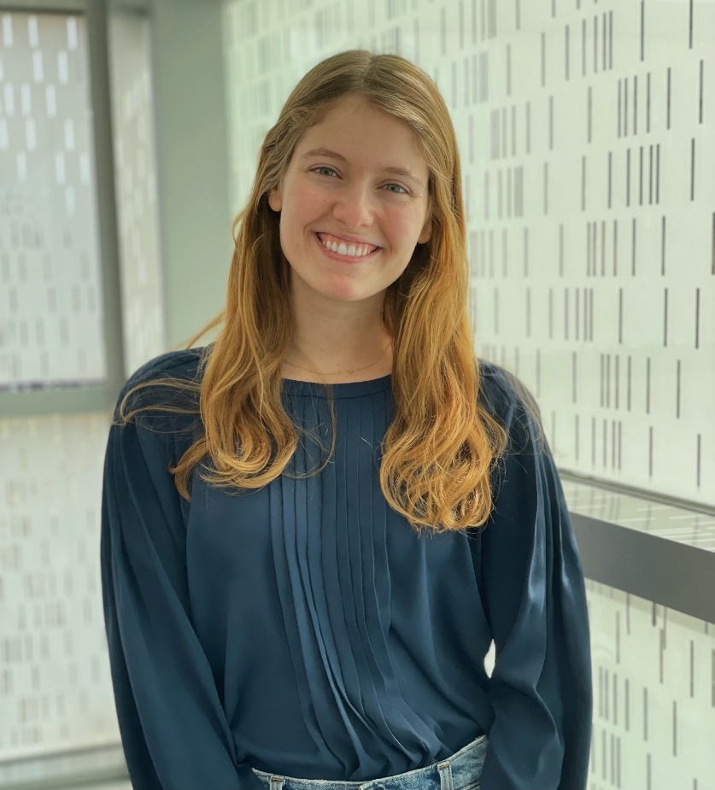
CAROLINE
DUNBAR
School of Science
Neuroscience
HIGHLIGHT:
Being a part of the Regatta Executive board as one of the Directors of Rules and Teams, enjoying courses both in and outside of her major, and playing on an intermural volleyball team.
HOMETOWN: NEW PALESTINE, IN

Slide 28
ARYN
EASH
School of Health & Human Sciences
Exercise Science
Minor(s): Nutrition
HIGHLIGHT:
Earning the Bepko Scholarship at IUPUI, and playing intramural sports on campus. Through this, Aryn met some amazing friends, stayed active, and got involved with the school.
HOMETOWN: LAKEVILLE, IN

Slide 29
EZZELDEEN
ELSAYED
School of Liberal Arts
Political Science, International Studies
Minor(s): Anthropology, Arabic, Islamic Studies
HIGHLIGHT:
Going to Iceland for a study abroad trip and graduating with honors.
HOMETOWN: FISHERS, IN

Slide 30
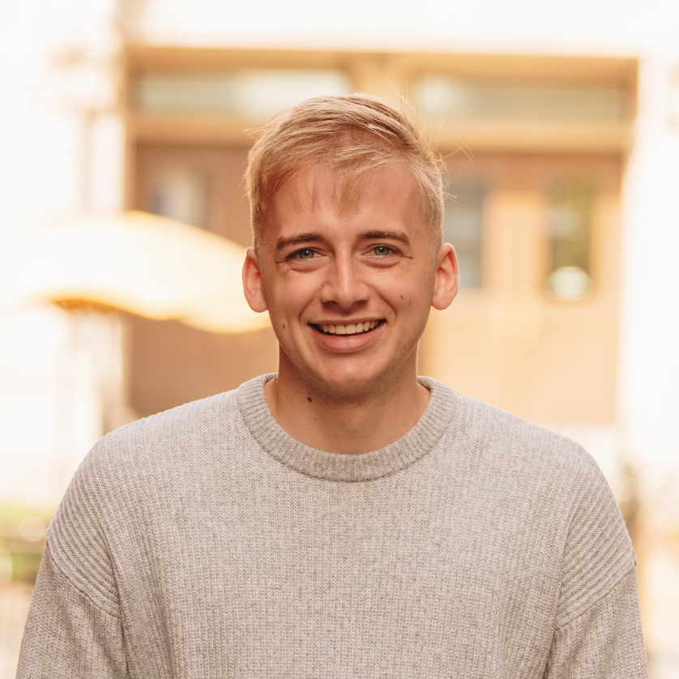
BRENDAN
FORESTER
Herron School of Art & Design
Visual Communications Design
HIGHLIGHT:
Admitted to the Orr Fellowship program, and was partnered with an amazing company, which he will work full-time for after graduation. Brendan’s favorite project he has worked on is his capstone project. He is also proud of himself for graduating with Honors.
HOMETOWN: LEBANON, IN

Slide 31
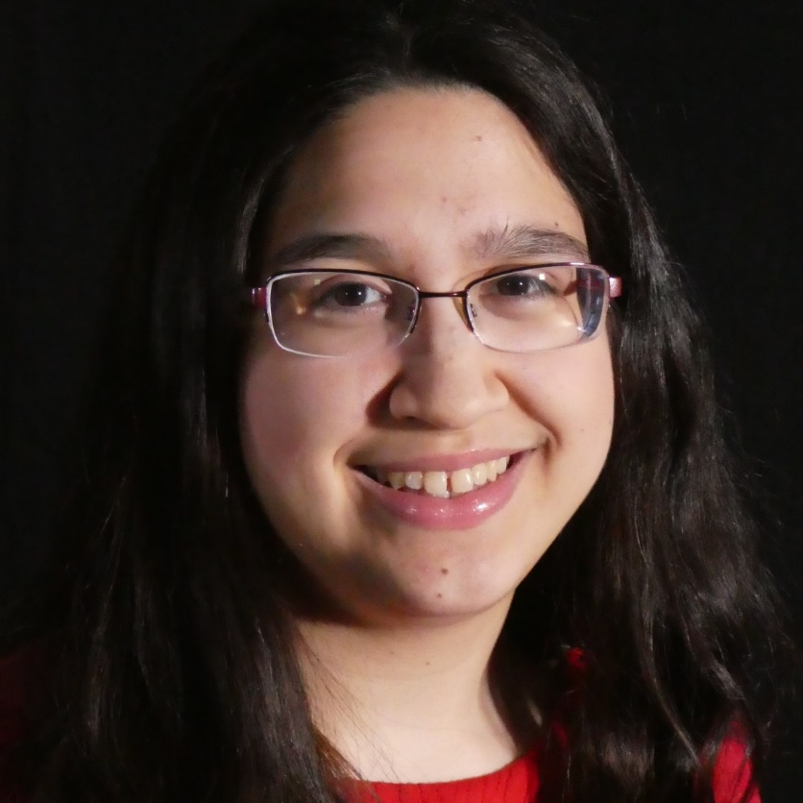
KATY
FULTON
Kelley School of Business
Accounting,
Supply Chain Management
HIGHLIGHT:
Getting to experience IUPUI’s Regatta, and participating in the Honors College Virtual Study Abroad class with Professor Ian McIntosh, where she learned about and shared her experience with the Sustainable Development Goals through the CourseNetworking platform, as well as collaborating with other students from IUPUI and Rwanda for a SDG project.
HOMETOWN: FISHERS, IN

Slide 32
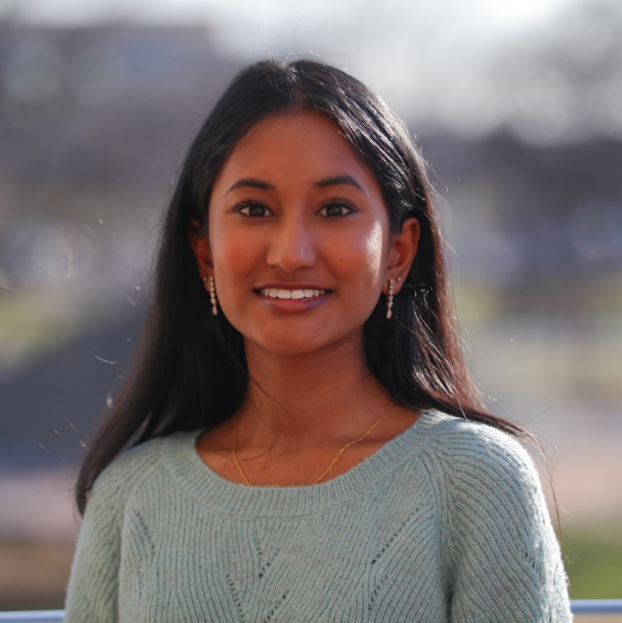
KARUNYA
GADE
School of Science
Biology
Minor(s): Chemistry
HIGHLIGHT:
Participating in Jagathon, especially Jagathon 2022, as it was the first in-person event in two years, as well as Karunya’s first in-person event as a director on the executive board. She is also grateful being able to do research as a freshman and senior in the Freshman Apprentice Program.
HOMETOWN: FISHERS, IN

Slide 33
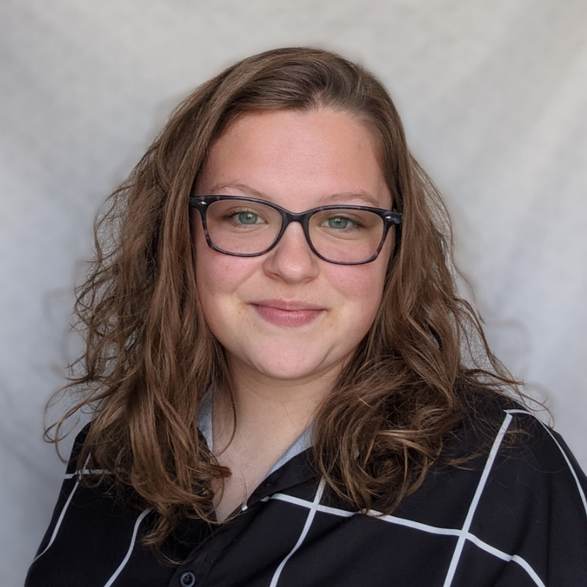
ALEXANDRA
GREGORY
School of Science
Interdisciplinary Studies
HIGHLIGHT:
Doing Jagathon, specifically their two years on the traditions committee
(2020 and 2022). Alexandra was also proud to earn the Top 100 award; and, she misses pre-COVID memories on campus: staying up late during finals week, coming back from the library at midnight with their friends, using random classrooms to study, petting the therapy dogs in the library, and getting insomnia cookies at 2 AM after they were done studying.
HOMETOWN: AVON, IN

Slide 34
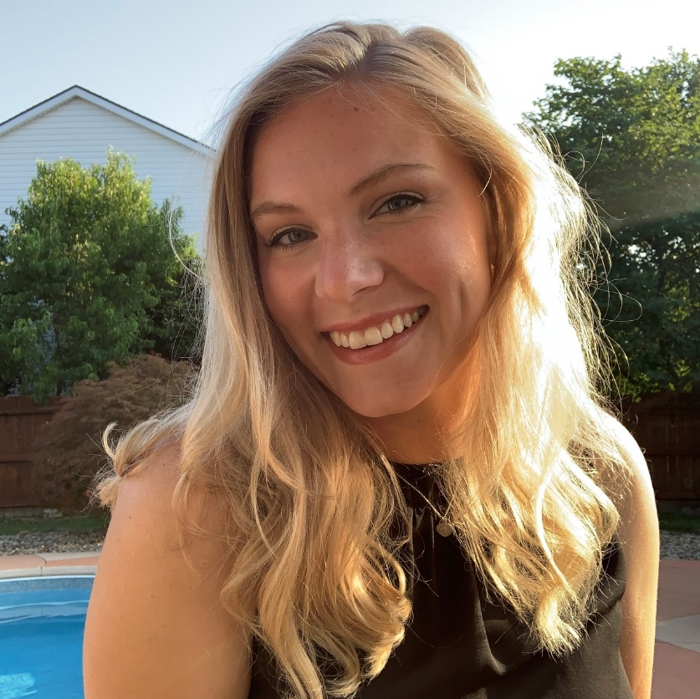
LAURYN
GROCE
Kelley School of Business
Marketing
Minor(s): Events Management, Sports Marketing
HIGHLIGHT:
Serving as the President of Women in Business within Kelley for a year and a half, serving as Professor Ketner's TA for her Strategic Management course, and serving on the Fundraising and Marketing committees for Jagathon (where Lauryn raised over $3,500 during her four years at IUPUI).
HOMETOWN: GREENWOOD, IN

Slide 35
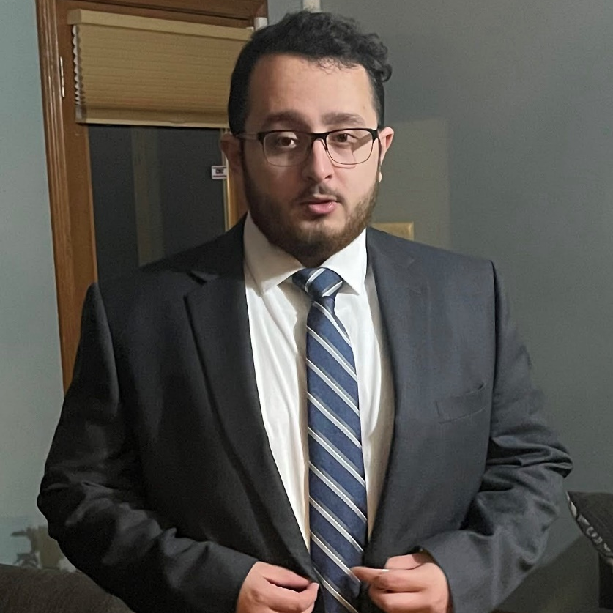
AMIR
HAILAT
School of Science
Neuroscience
HIGHLIGHT:
Winning Top 100, becoming a K101 mentor and PLTL leader, and taking a course for Organic Chemistry.
HOMETOWN: FISHERS, IN

Slide 36
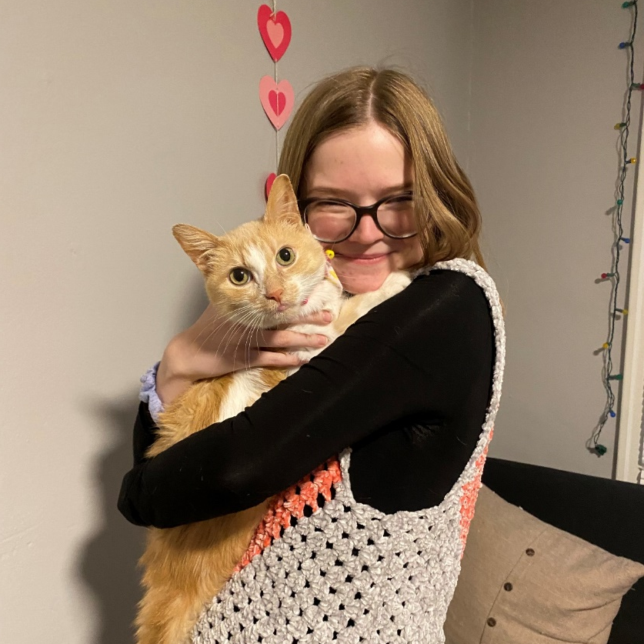
GRACE
HAMILTON
School of Science
Mathematics Teaching
Minor(s): Psychology
HIGHLIGHT:
Received the Outstanding Math Teaching Senior award, worked as a math mentor in a couple of FYS courses, and worked with Doan Le as a grader in the math department, as well as an auxiliary aid in one of her summer courses.
HOMETOWN: FISHERS, IN

Slide 37
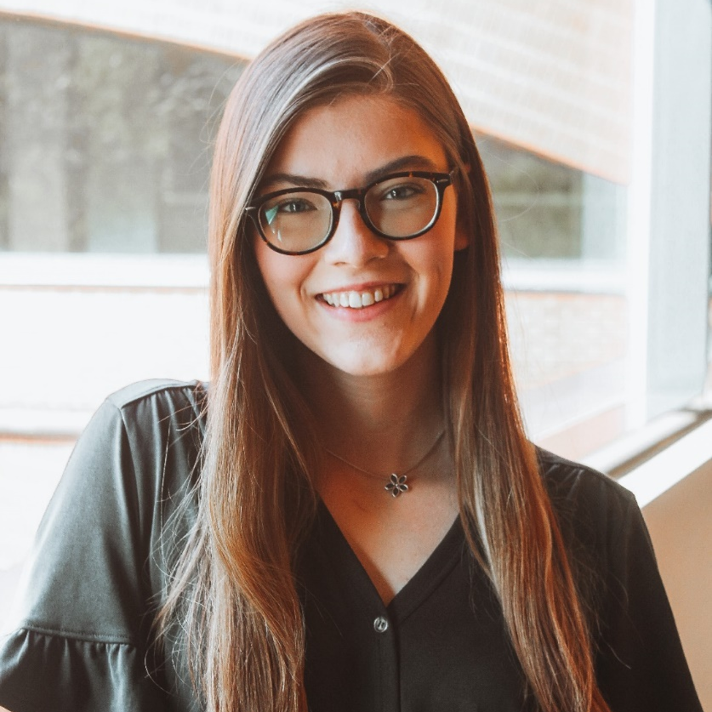
LAUREN
HARLESS
School of Health & Human Sciences
Exercise Science
Minor(s): Health Psychology
HIGHLIGHT:
Designing and carrying out a research project that looks at how gait changes amongst people when distracted; participating in the 10-week INShape program as a personal trainer, helping her client reach their goals; and, meeting with friends before Biology exams to study and get bubble tea.
HOMETOWN: BROWNSBURG, IN

Slide 38
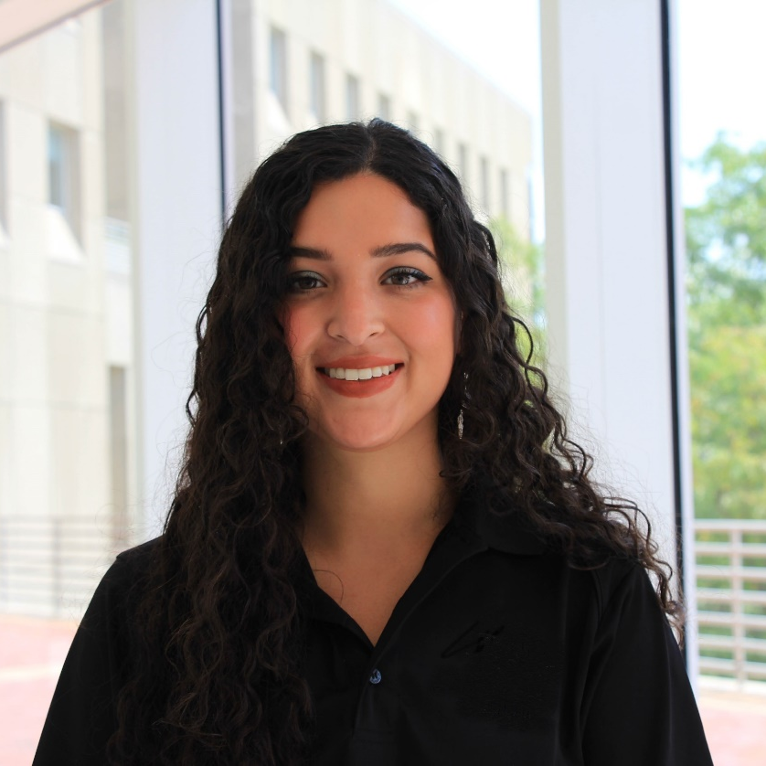
REBECA
HAYES
School of Science
Psychology
Minor(s): Spanish
HIGHLIGHT:
Excelling in school as a first generation Latina scholar and being able to get so many opportunities, like internships and getting into graduate school. Rebeca is also grateful for the people she has met throughout her four years at IUPUI.
HOMETOWN: NOBLESVILLE, IN

Slide 39
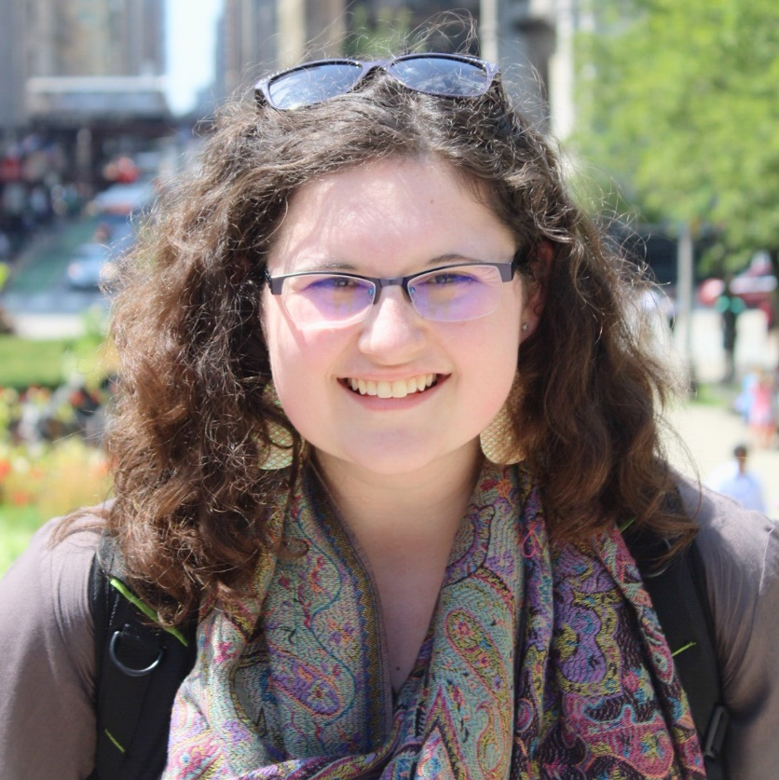
ANNA
HEILERS
School of Public Health
Epidemiology
HIGHLIGHT:
Leading the Fairbank's School of Public Health Undergraduate Student Association as President; working with the Indiana Department of Health on EVALI, COVID-19, and Tuberculosis; and, being in the Top 100 for both 2021 & 2022.
HOMETOWN: BROWNSBURG, IN

Slide 40
BRADEN
HERENDEEN
Kelley School of Business
Finance
Minor(s): Economics
HIGHLIGHT:
Serving in Christian Student Fellowship as a life group leader, as a worship team member, and as the VP of Volunteering; shifting from a Pre-Med track to pursuing a career in finance; and, assembling gift baskets for community leaders and medical staff to deliver during pandemic lockdowns.
HOMETOWN: EVANSVILLE, IN

Slide 41
CORTNEY
HOLDER
Kelley School of Business
Accounting,
Supply Chain Management
HIGHLIGHT:
Being President of the Student Activities Programming Board, and a Resident
Assistant at University Tower.
HOMETOWN: NEW ALBANY, IN

Slide 42
COURTNEY
HUTSLAR
School of Science
Neuroscience
Minor(s): Biology, Chinese, Psychology
HIGHLIGHT:
Being an Honors College Peer Mentor and getting to work with/become friends with mentees in the program, and staying on the Science Scholars List throughout her college career.
HOMETOWN: GREENWOOD, IN

Slide 43
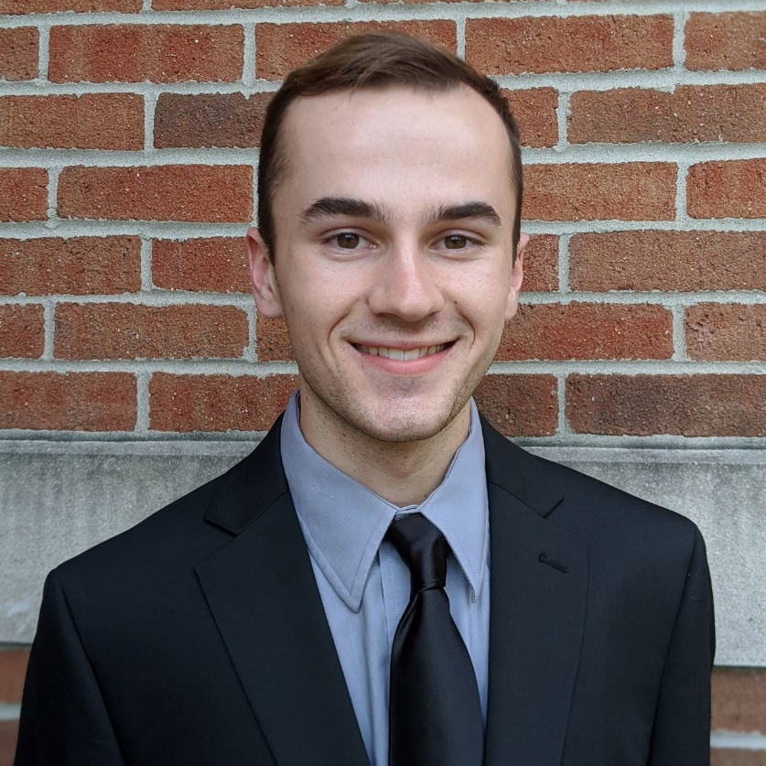
LUKE
JACKSON
School of Science
Biochemistry
Minor(s): Spanish
HIGHLIGHT:
Being involved in extracurricular research, which led to involvement in three different programs: the Life Health Sciences Internship program, the Undergraduate Research Opportunity Program, and the larger Indiana University Undergraduate Research Conference; and, volunteering as part of the Honors College.
HOMETOWN: FORT WAYNE, IN

Slide 44
REBEKAH
JACKSON
School of Science
Chemistry, Forensic Science
Minor(s): Mathematics
HIGHLIGHT:
Attending the summer bridge program and being able to do research through the LHSI and UROP programs.
HOMETOWN: FRANKLIN, OH

Slide 45
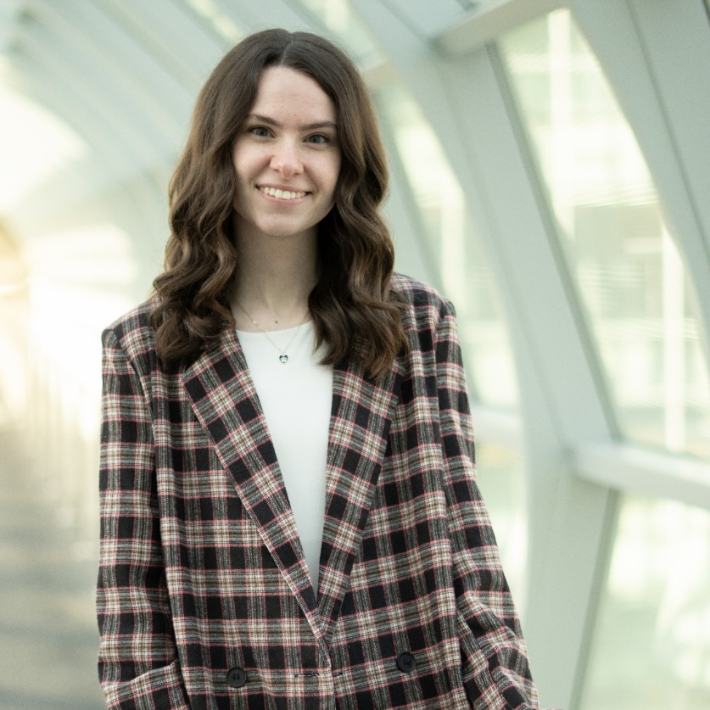
SOPHIA
JAEGLY
School of Informatics & Computing
Media Arts & Science
HIGHLIGHT:
Attended and completed projects for Jagathon, worked in three campus offices, is a patron of Regatta, WOW, and SAPB events, as well as being a member of the Alpha Lamda Delta Phi Eta Sigma honor societies. Sophia will also be the last graduate of the School of Informatics and Computing's Masters in Media Arts & Science program, as the track transforms into Human-Computer Interaction.
HOMETOWN: TOLEDO, OH

Slide 46
SHUBHANKAR
JAPE
School of Engineering & Technology
Electrical Engineering
Minor(s): Mathematics
HIGHLIGHT:
Research experience with Dr. Rovnyak, and with
Dr. Decca, as well as being in IUPUI’s Top 100.
HOMETOWN: PUNE, INDIA

Slide 47
MITCH
JOHNSTON
Kelley School of Business
Accounting
Minor(s): Data Science
HIGHLIGHT:
Being part of GM Case Comp, earning a Top 100 nomination, and having three internships with EY.
HOMETOWN: BLOOMINGTON, IN

Slide 48
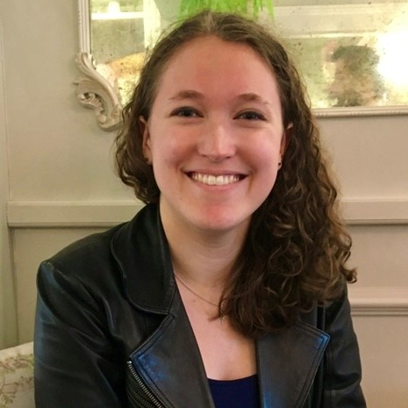
KAYLEIGH
JONES
School of Informatics & Computing
Media Arts & Science
Minor(s): Creative Writing
HIGHLIGHT:
Attending the Game Developers Conference in San Francisco and getting to meet several people in the game industry and listen to really thought-provoking talks on Games UX. Kayleigh also says coming to IUPUI boosted her confidence and made her more independent. She also made great friends for life here.
HOMETOWN: PICKERINGTON, OH

Slide 49
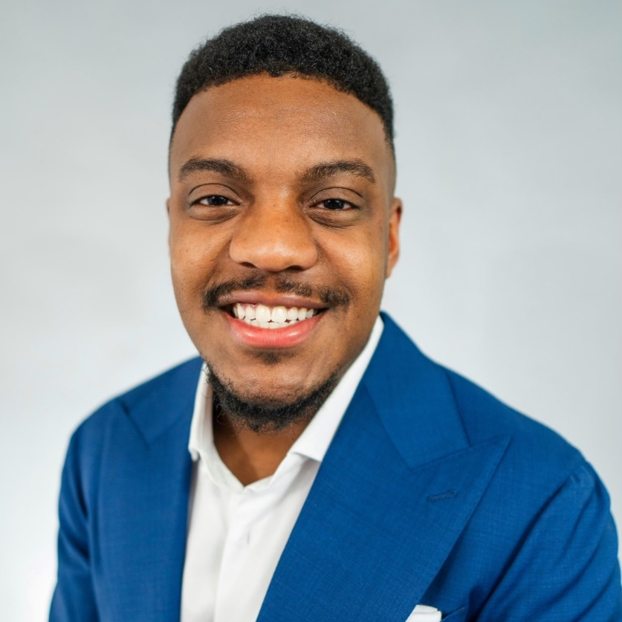
RYLANE
JONES
School of Health & Human Sciences
Exercise Science
Minor(s): Certificate in Personal Training
HIGHLIGHT:
Being a Norman Brown Scholar, graduating with Honors, making the Dean’s List, getting engaged to his fiancé and finding his dream career.
HOMETOWN: NOBLESVILLE, IN

Slide 50
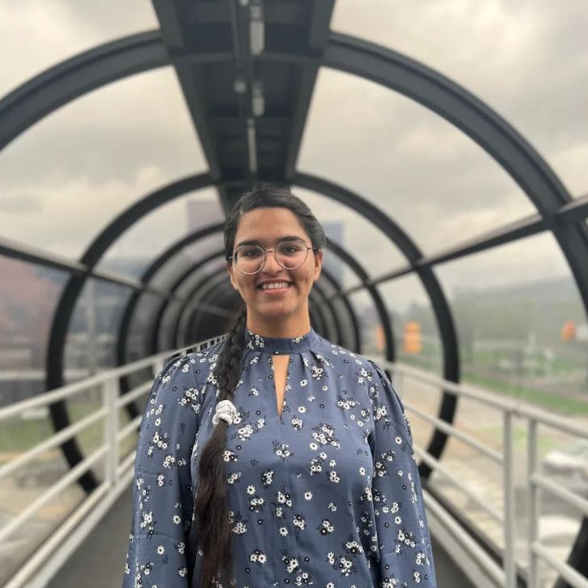
JAPNEET
KAUR
School of Science
Computer Science
Minor(s): Mathematics
HIGHLIGHT:
Being identified as graduating with distinction, making amazing connections with her friends and faculty, gaining amazing mentorship from her favorite professors, and performing as a finalist in the Curtis Memorial Speech Contest.
HOMETOWN: PUNJAB, INDIA

Slide 51
SUKHDEEP
KAUR
School of Public & Environmental Affairs
Criminal Justice & Law
HOMETOWN: GREENWOOD, IN

Slide 52
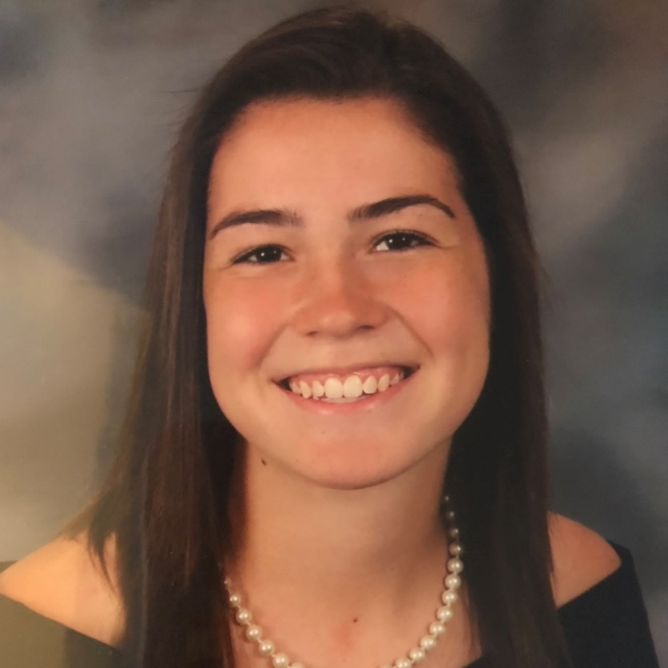
ALLISON
KEISER
School of Health & Human Sciences
Exercise Science
HIGHLIGHT:
Being recognized as one of the Top 10 students at IUPUI and maintaining a 4.0 GPA throughout her college career.
HOMETOWN: TERRE HAUTE, IN

Slide 53
ANNABELLE
KETCHEM
School of Science
Psychology, Spanish
HIGHLIGHT:
Being involved with College Mentors for Kids, meeting Dr. Bepko, and working with Bethany Christian Services. Annabelle volunteered as a teaching assistant with the refugee foster kids who have been rescued from the border.
HOMETOWN: BROWNSBURG, IN

Slide 54
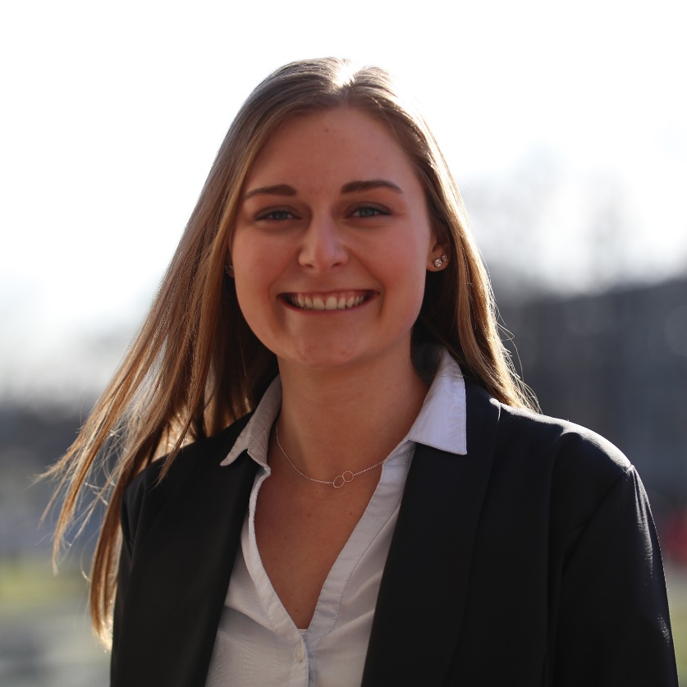
ABBIE
KOSTER
School of Engineering & Technology
Interior Design Technology
Minor(s): German
HIGHLIGHT:
Met her fiancé at IUPUI and got engaged on the canal the week before Regatta in 2021; won the Regatta Royalty award and scholarship; was involved in Delta Zeta serving as the President, Vice President of Philanthropy, Chaplain, and Sisterhood Chairman throughout her time as an active member; was awarded the College Panhellenic President of the Year award; served as the Vice President of the Student Design Organization; helped the executive board
plan a design show.
HOMETOWN: CHESTERTON, IN

Slide 55
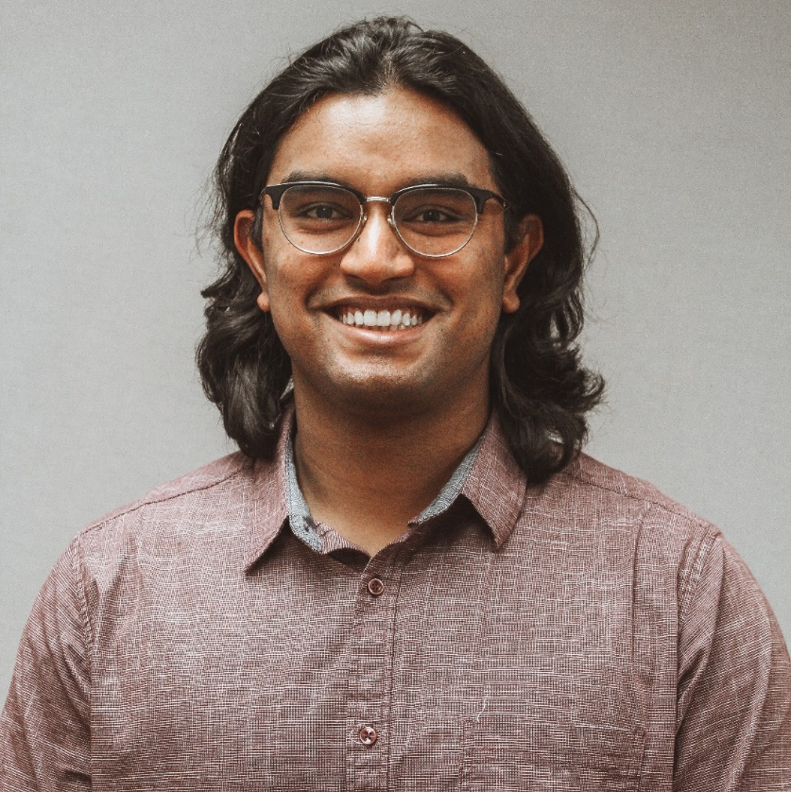
SATYAJIT HARI
KULKARNI
School of Science
Biology, Chemistry
Minor(s): Mathematics
HIGHLIGHT:
Peer-reviewed a scientific publication, earned the Chemistry Undergraduate Summer Research Scholarship and won the Distributed Drug Discovery Award for Excellence in Organic Chemistry.
HOMETOWN: PUNE, INDIA

Slide 56
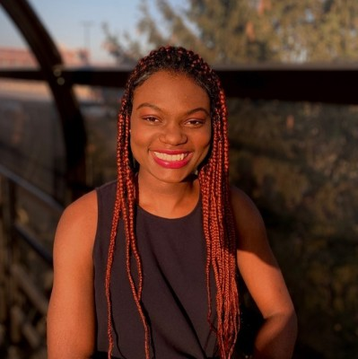
ZOLA
LAMOTHE
Kelley School of Business
Marketing
Minor(s): Africana Studies, Graphic Design
HIGHLIGHT:
Being one of the first Social Justice Resident Assistants in Housing and residence life, creating and directing the Pretty Privilege room in this fall's Tunnel of Oppression, and serving on the executive board of the Black Student Union and building a community where a lot of Black students feel lost or undervalued.
HOMETOWN: INDIANAPOLIS, IN

Slide 57
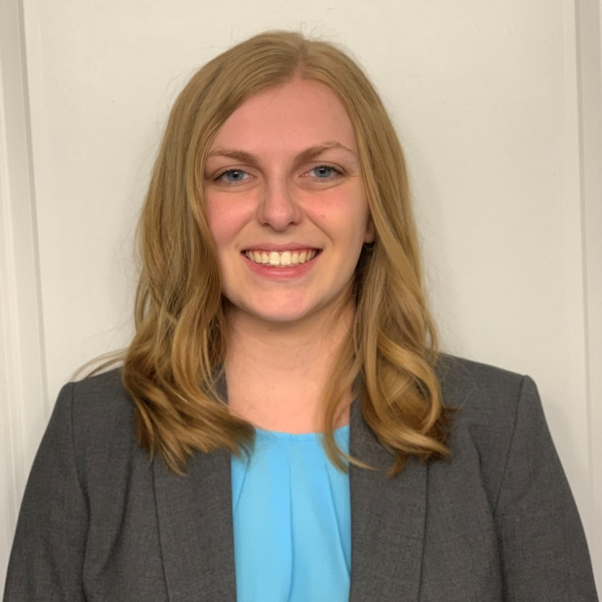
MACKENZI
LAWSON
School of Science
Neuroscience
Minor(s): Spanish
HIGHLIGHT:
Getting into medical school and
being named Top 100 this year.
HOMETOWN: HILLSBORO, IL

Slide 58
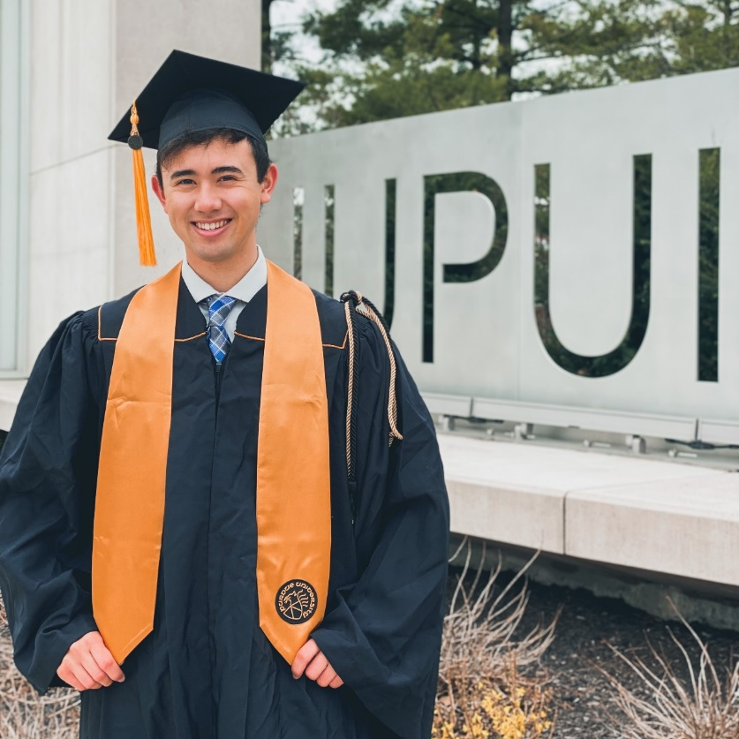
LOGAN
LEW
School of Science
Biology
Minor(s): Health Administration
HIGHLIGHT:
Was named one of the Top 100 students, studied abroad in Denmark through DIS and IU Bloomington, and worked as a patient care technician at IU Health in the ICU and acuity adaptable unit through the pandemic during the past 2 years.
HOMETOWN: FORT WAYNE, IN

Slide 59
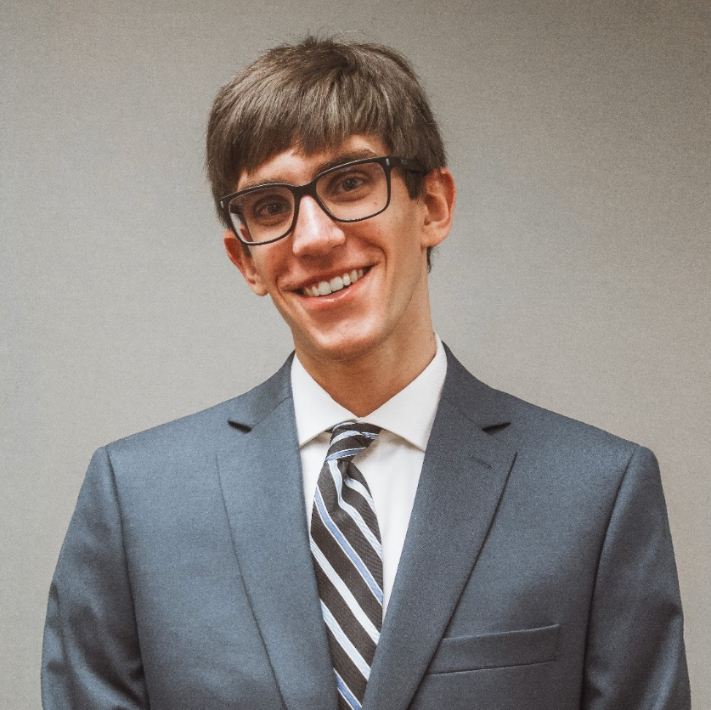
JONATHON
LEWIS
School of Public & Environmental Affairs
Sustainability Management and Policy
HIGHLIGHT:
Led the Energy Challenge for the IUPUI Office of Sustainability, completed a Standard Operating Procedure for the Energy Challenge as an honors contract, ran the Energy Challenge about two years later, awarded the Top 100, and worked on greenhouse gas calculations for several big sporting events.
HOMETOWN: CARY, IL

Slide 60
SARAH
LOUNSBURY
School of Liberal Arts
Journalism
Minor(s): Sports Marketing, Communications Studies
HIGHLIGHT:
Was a member of the IUPUI women’s tennis team and was recognized as an Intercollegiate Tennis Association (ITA) Scholar Athlete in 2019, 2020 and 2021. Sarah has landed her dream internship at BLASTMedia, which is a public relations agency in Indianapolis, and she will begin her internship in May of 2022. Also, her writing was featured numerous times on the IUPUI Athletics website and also in the IU School of Social Work 2021 Research Magazine.
HOMETOWN: LEES SUMMIT, MO

Slide 61
KYLE
MALONEY
School of Engineering & Technology
Mechanical Engineering
HOMETOWN: KEENESBURG, CO

Slide 62
MEGAN
MASI
School of Science
Neuroscience, Biology, Chemistry, Forensics
HOMETOWN: HUNTLEY, IL

Slide 63
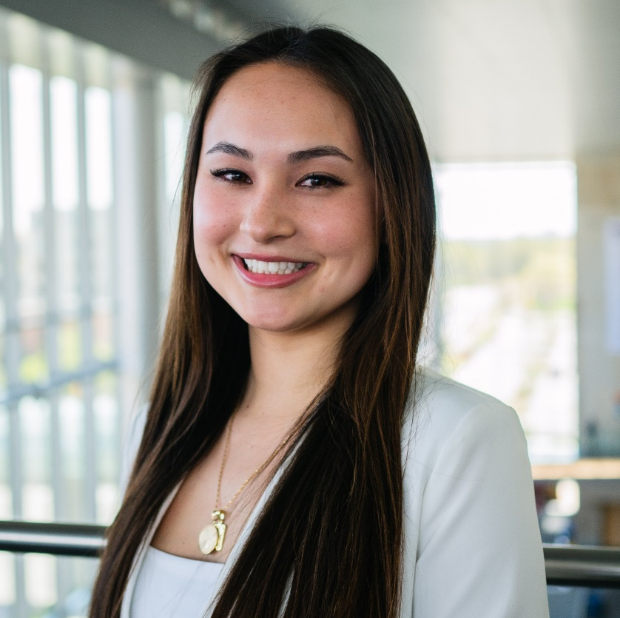
ALYSSA
MATHIS
School of Science
Biology
HIGHLIGHT:
Made the Dean's List every semester, qualified as a Science Scholar, cofounded a multicultural club at IUPUI: Jaguars and Asian Americans Dedicated to Excellence, and worked in two Bone Biology labs on campus: Dr. Jiliang Li's lab and Dr. Melissa Kacena's lab.
HOMETOWN: CARMEL, IN

Slide 64
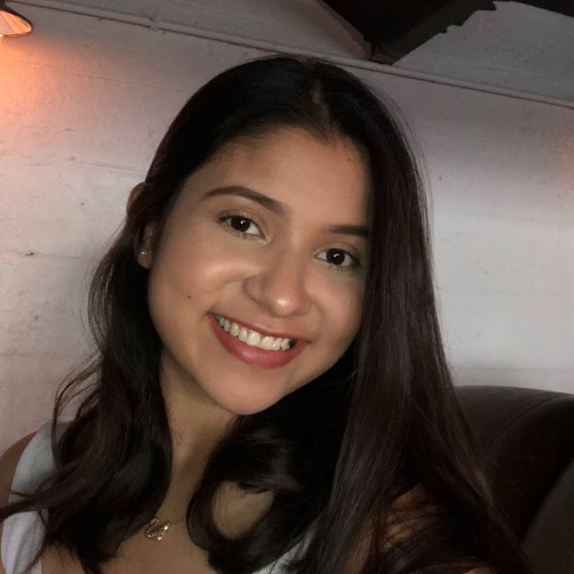
PAULINA
MEDINA
School of Health & Human Sciences
Health Sciences
Minor(s): Nutrition
HIGHLIGHT:
Attended the IUPUI Top 100 ceremony this year as a recurrent honoree.
HOMETOWN: GOSHEN, IN

Slide 65
NOAH
MISKIMEN
Kelley School of Business
Accounting, Finance, Supply Chain
HIGHLIGHT:
Enjoyed spending time in the Honors College, hanging out with friends, studying, or taking a break to play games. Noah also said he was grateful to learn from some of his professors that really go out of their way for students.
HOMETOWN: INDIANAPOLIS, IN

Slide 66
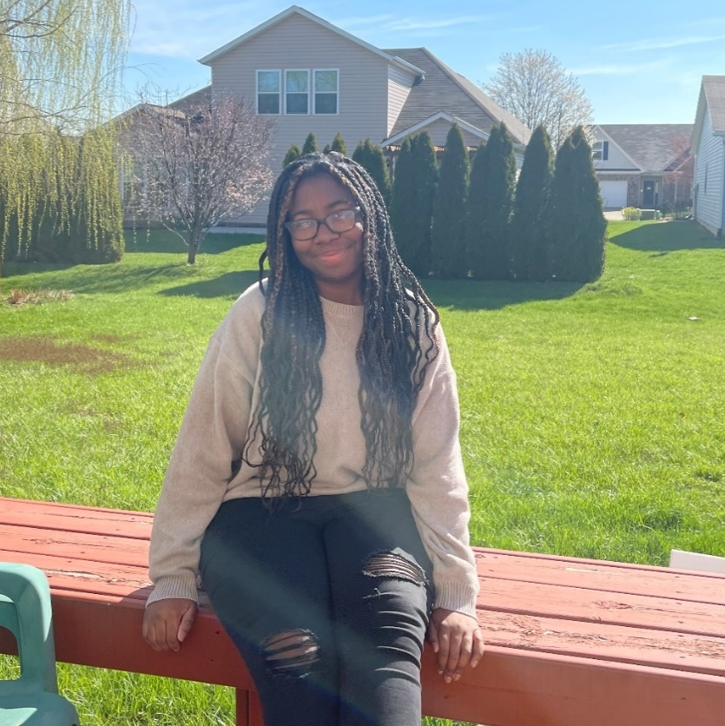
CLEMETTE
MORRIS
School of Health & Human Sciences
Health Sciences
Minor(s): Global & International Studies
HIGHLIGHT:
Becoming a co-author on a published journal article after completing an LHSI internship in Spring 2020, and meeting and speaking to Dr. Bepko in 2019.
HOMETOWN: AVON, IN

Slide 67
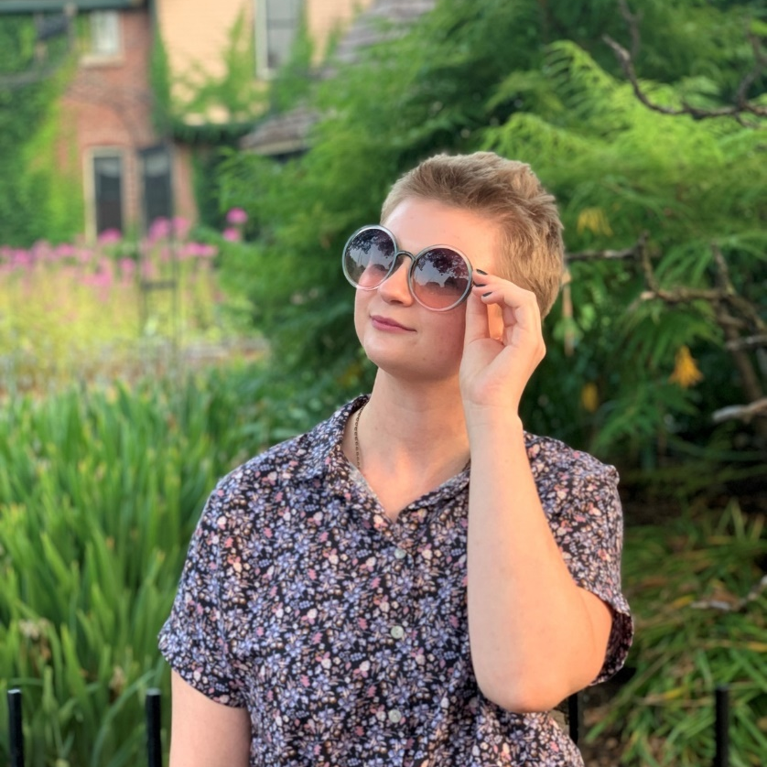
JULIA
NEWBOLD
School of Science
Neuroscience
Minor(s): Biology, Psychology
HIGHLIGHT:
Volunteering with Wheeler Mission and Gleaners Food Bank, and working as a Peer Leader in the Chemistry PLTL program. Through the program, Julia has been able to help incoming freshman adjust to a new environment and understand content that many people find inaccessible.
HOMETOWN: TRAFALGAR, IN

Slide 68
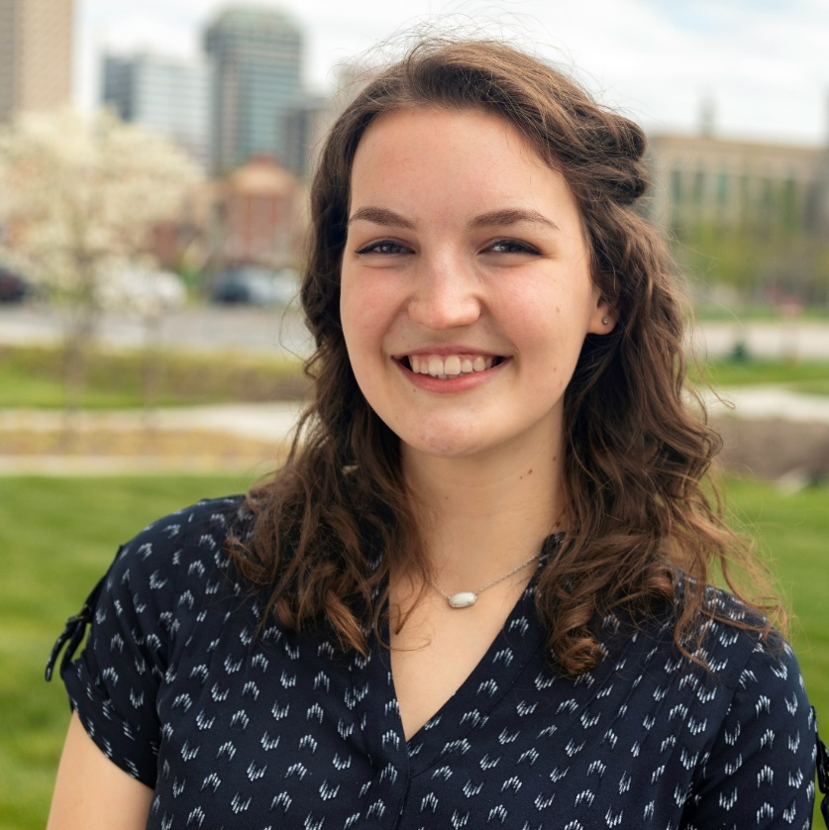
VERAYNA
NEWLAND
School of Science
Biology
Minor(s): Chemistry
HIGHLIGHT:
Participating in the Women in Science House allowed Verayna to step into leadership roles, grow academically, and give back to the community. She enjoyed leading different committees, participating on the Executive Board, and then becoming President. She also got hands-on experience in a lab and mentoring from IUPUI faculty through the First Year Apprenticeship Program. Verayna was also chosen as a student in the Top 100.
HOMETOWN: GREENTOWN, IN

Slide 69
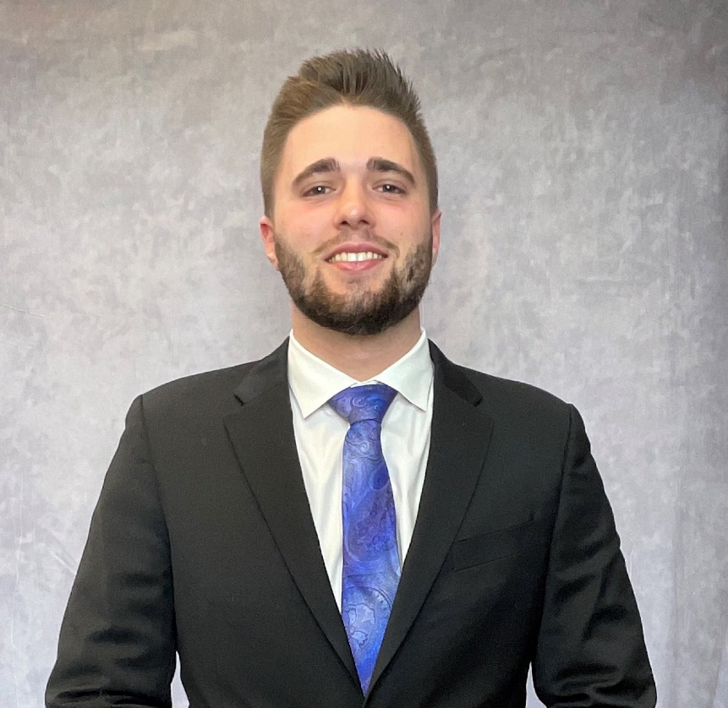
WALKER
NURRENBERN
School of Science
Chemistry
Minor(s): Business
HIGHLIGHT:
Seeing a goal of his come to fruition in being a Top 100 Student at IUPUI.
HOMETOWN: FRANCISCO, IN

Slide 70
AMBER
PAGAN
School of Science
Chemistry
HOMETOWN: BARTLETT, IL

Slide 71
KELSEY
PARDIECK
School of Science
Forensic & Investigative Science, Biology
Minor(s): Chemistry, Art
HIGHLIGHT:
Graduating.
HOMETOWN: INDIANAPOLIS, IN

Slide 72
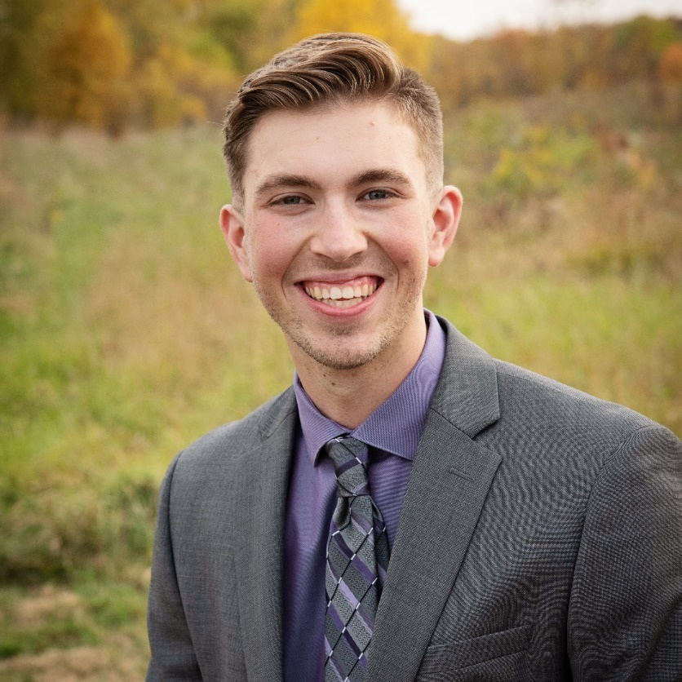
REGGIE
PARKER
School of Science
Biology
HIGHLIGHT:
Throughout his time as Vice President of Advocacy for VIDA Health Partnerships, they were able to grow the organization from 107 members to the largest student organization on campus with 333 members. They also increased from 22 to 33 advocacy events and their members completed 1320+ service hours during the 2021-2022 year. Reggie was also awarded the Plater Civic Engagement Medallion. He earned a position in the LHSI program in a research lab studying bone disease where Reggie identified a possible therapeutic drug for the treatment of osteopetrosis.
HOMETOWN: ALBION, IN

Slide 73
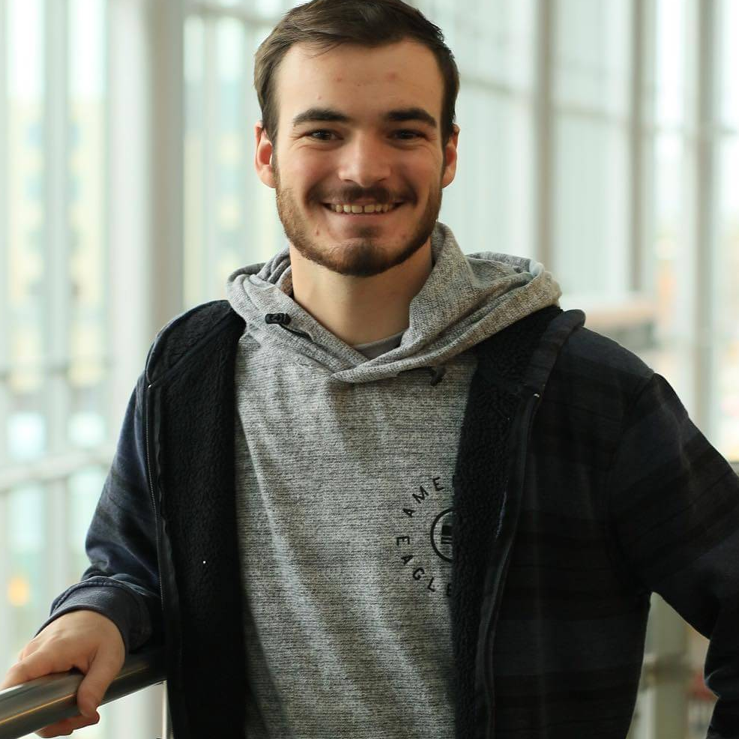
JACOB
PARMENTER
School of Engineering & Technology
Biomedical Engineering
Minor(s): Mathematics
HIGHLIGHT:
Creating his BME Capstone Project (a training model for invasive prenatal procedures), being part of the Honors Adventure Club, as well as being part of On A Side Note: a semi-professional and competitive collegiate a capella group.
HOMETOWN: EVANSVILLE, IN

Slide 74
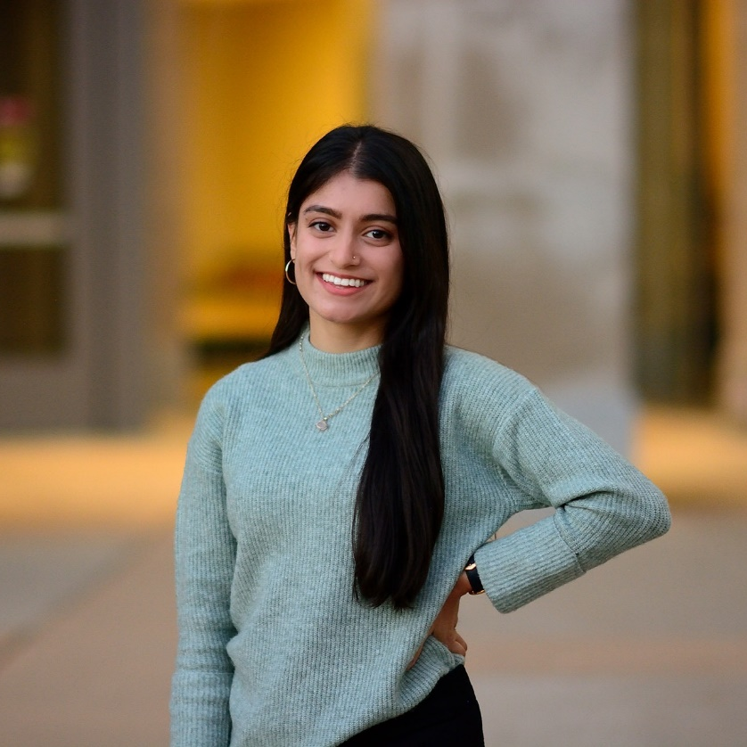
JANVI
PATEL
School of Science
Biology
Minor(s): Business
HIGHLIGHT:
Having the opportunity to work alongside ophthalmology researchers while being in the Life-Health Sciences Internship and ending the internship to be awarded the Best ePortfolio; publishing a paper in ophthalmology research, specifically about diabetic retinopathy education; and, founding Kriya, a yoga club on campus, and growing the organization to name recognition with over 100 members.
HOMETOWN: PLAINFIELD, IN

Slide 75
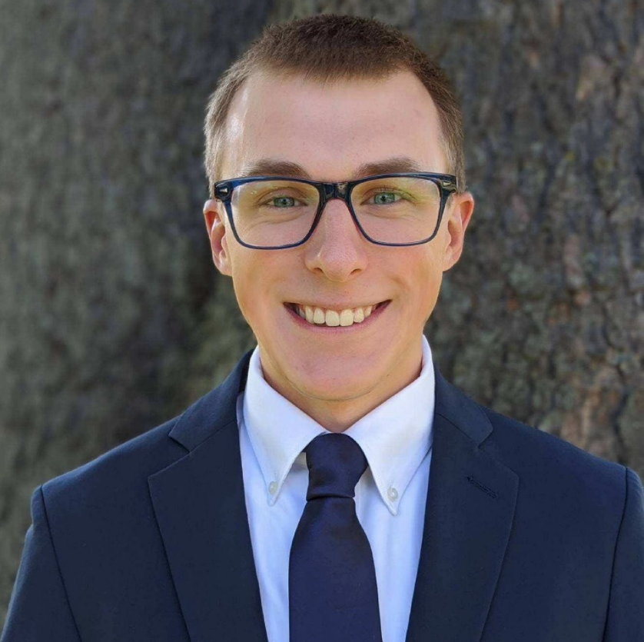
NATHAN
PETERS
School of Public Health
Health Data Science
Minor(s): Mathematics, Informatics
HIGHLIGHT:
Meeting with Karley Clayton, a career advisor at IUPUI, that pointed him in the right direction and introduced him to a major and career that is perfect for him. Nathan has also received the FSPH Outstanding Student award, which honors a graduating public health student who has demonstrated excellence in various ways.
HOMETOWN: ONEIDA, IL

Slide 76
BRADLEY
PHIPPS
Kelley School of Business
Human Resource Management
Minor(s): Leadership
HIGHLIGHT:
Nominated as an IUPUI Top 100 student and finalist for the J. Dwight Peterson Key Award; served on the Kelley School of Business Dean's Insight Board, the Kelley Honors Advisory Board, and the Honors College Student Council; and, worked with Dr. Christopher Porter, Dr. Stephanie Andel, and several graduate students as a member of a productive research lab with multiple ongoing research projects in the OBHR and I/O Psychology domain.
HOMETOWN: ALEXANDRIA, IN

Slide 77
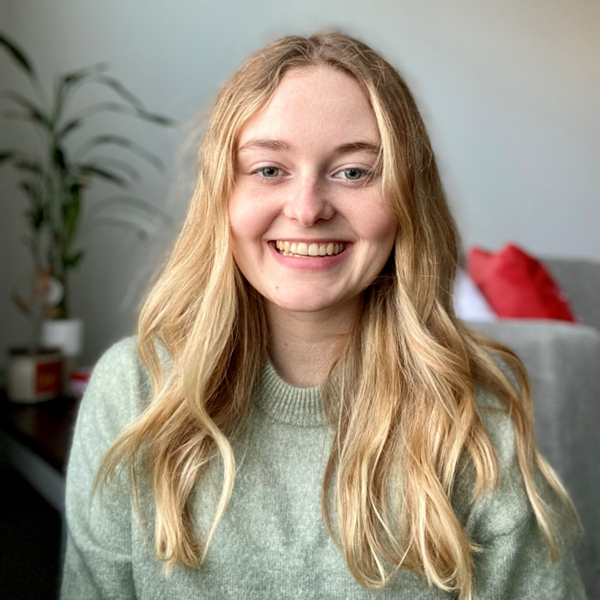
VALERIE
POKORNY
School of Science
Environmental Science,
Sustainable Management & Policy
HIGHLIGHT:
Going on an exchange semester in Alaska with the National Student Exchange, being named the O’Neill’s Chancellor’s Scholar, and getting to be a part of undergraduate research as part of the MURI program.
HOMETOWN: GRAZ, AUSTRIA

Slide 78
FAITH
PROCHASKA
School of Science
Neuroscience, Biology
Minor(s): Health Communication
HIGHLIGHT:
Research with Dr. Randall J. Roper's lab on campus, where she was able to publish her work as co-first author. Through her research with Dr. Randall J. Roper's lab, Faith was also able to present her work at many conferences. She was also awarded the IUPUI Outstanding Undergraduate Research Award in Biology, Bowling-Jones Russo Memorial Undergraduate Research Award, and IUPUI Baccalaureate Outstanding Research Award in Biology for her research, as well as being named a Top 100 student for two years.
HOMETOWN: FORT WAYNE, IN

Slide 79
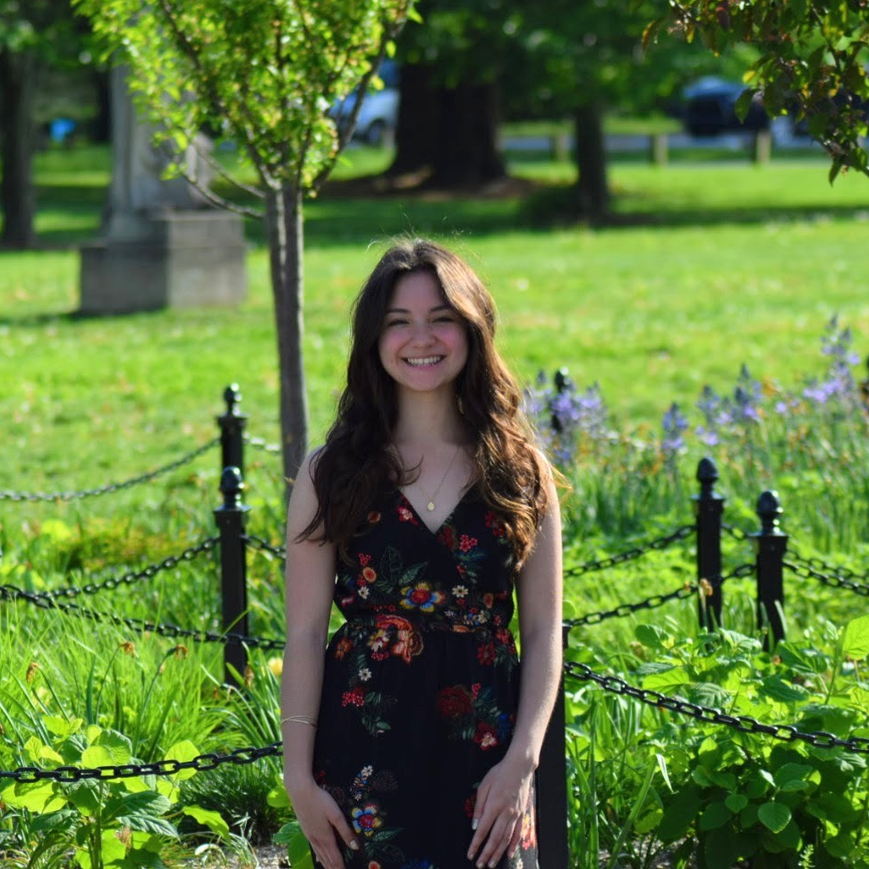
GIANNINA
RAMIREZ
School of Science
Environmental Science
Minor(s): Biology
HIGHLIGHT:
Became an Indiana Louis Stokes Alliance for Minority Participation research scholar and started her interest in a technical research career; worked with
Dr. William Gilhooly of the IUPUI Department of Earth Sciences on her undergraduate research project over paleoclimate reconstructions of a tropical lake using geochemical proxies; designed and installed IUPUI's
first native pollinator garden on campus; and, was an Adam W. Herbert Presidential scholar and received a four-year renewable scholarship.
HOMETOWN: INDIANAPOLIS, IN

Slide 80
NITYA
RANJAN
School of Engineering & Technology
Computer Engineering
Minor(s): Computer Science
HIGHLIGHT:
Attending a research trip.
HOMETOWN: BANGALORE, INDIA

Slide 81
CLAIRE
RICHARDSON
School of Education
Elementary Education
Minor(s): Music, Psychology
HIGHLIGHT:
Meeting, dating, and getting engaged to her fiancé in the IUPUI Jag Band; and, receiving the honor of Top 100.
HOMETOWN: BROWNSBURG, IN

Slide 82
EMMA
RICHARDSON
School of Informatics & Computing
Media Arts & Science
HIGHLIGHT:
Being accepted into the Honors College, maintaining an A/B average, and getting nominated for Top 100.
HOMETOWN: MARTINSVILLE, IN

Slide 83
MEGHANA
SANKAR
School of Science
Biology
Minor(s): Medical Humanities & Health Studies, Mathematics
HIGHLIGHT:
Recognized as a Top 100 student for two years; served as the VIDA Health Partnerships Director of the IU Student Outreach Clinic (SOC), helping provide health care services to the underserved community; and, mentored peers as a PLTL recitation leader for General and Organic Chemistry.
HOMETOWN: CARMEL, IN

Slide 84
KATIE
SAXON
School of Health & Human Sciences
Tourism, Event & Sport Management
Minor(s): Business Foundations Certificate
HIGHLIGHT:
Being in Indianapolis and having incredible internship opportunities for all majors.
HOMETOWN: DEMOTTE, IN

Slide 85
HANNA
SCHREIBER
School of Science
Biology
Minor(s): Medical Humanities &
Health Studies
HIGHLIGHT:
Receiving her acceptance to IU's PA program last fall, studying abroad in Costa Rica, and getting named as one of the IUPUI Top 100 Students.
HOMETOWN: FORT WAYNE, IN

Slide 86
EMMA
SCHWARTZ
Herron School of Art & Design
Drawing & Illustration
Minor(s): Art History
HIGHLIGHT:
Had her essay "Gender Roles in Ancient Mesoamerica" featured at the IU Women's and Gender Studies Undergraduate Conference in 2021.
HOMETOWN: LINCOLN, NEBRASKA

Slide 87
DYLAN
SEQUEIRA
School of Engineering & Technology
Mechanical Engineering
Minor(s): Mathematics
HIGHLIGHT:
Getting an internship before graduating, working at the MAC for 7 semesters, and co-directing the International Culture show for the International Club.
HOMETOWN: DUBAI, UNITED ARAB EMIRATES

Slide 88
LOGAN
SHELMADINE
School of Science
Biology, Neuroscience, Psychology
Minor(s): Chemistry
HIGHLIGHT:
Making it through Organic Chemistry.
HOMETOWN: MACKINAW, IL

Slide 89
HANNAH
SMELTZER
School of Science
Neuroscience
Minor(s): Creative Writing, Storytelling
HIGHLIGHT:
Helping establish an Out in STEM chapter at IUPUI, participating in the LHSI program and interning with Dr. Clark Wells in his Biochemistry and Molecular Biology lab, and volunteering with the Children's Bureau as a sexual assault advocate.
HOMETOWN: BREMEN, IN

Slide 90
ANDRIANA
SMITH
Kelley School of Business
Marketing, International Studies
Minor(s): Spanish
HIGHLIGHT:
Being named a Top 100 student, being awarded Regional Collegian of the Year 2022 through Delta Sigma Pi, and their canoe tipping over during her final Regatta – but they got back in and finished the race!
HOMETOWN: WINAMAC, IN

Slide 91
JAMIE
SMITH
School of Health & Human Sciences
Tourism, Conventions &
Event Management
Minor(s): Communications Studies
HIGHLIGHT:
Completing TESM-E 404: a capstone course centered around planning an event from scratch; making the Dean's List and being accepted into the Honors College; and, making life-long friends and memories at IUPUI.
HOMETOWN: NOBLESVILLE, IN

Slide 92
OLIVIA
STROBEL
School of Science
Chemistry
Minor(s): French
HIGHLIGHT:
Coming back to a full campus at the beginning of the Fall 2021 semester after being on a pretty empty campus the school year before, and being a chemistry TA and recitation leader.
HOMETOWN: FISHERS, IN

Slide 93
TAYLOR
TARGGART
Kelley School of Business
Human Resource Management, Business Management
Minor(s): Health Systems Administration
HIGHLIGHT:
Being named an IUPUI Top 100 student, receiving a Society for Human Resource Management (SHRM) Scholarship, and being so involved on campus in many different student organizations.
HOMETOWN: WOLCOTTVILLE, IN

Slide 94
LAUREN
TAYLOR
Kelley School of Business
Marketing
HIGHLIGHT:
Being on the Executive Board for the Women in Business Club, getting into the Kelley Honors Program, and finishing her undergraduate degree
in three years instead of four.
HOMETOWN: PLAINFIELD, IN

Slide 95
OLIVIA
VICORY
School of Liberal Arts
American Sign Language,
English Interpreting
Minor(s): Sociology
HIGHLIGHT:
Jagathon 2022, which was the first in-person Jagathon put on in the last two years. Olivia said it was so rewarding after a year of serving as the Director of Recruitment and getting to do it all with some of her best friends.
HOMETOWN: FISHERS, IN

Slide 96
J.B.
WALTERS
School of Engineering & Technology
Computer Information & Technology
Minor(s): Network, Information Security
HIGHLIGHT:
Working at the university in technology services at DUE.
HOMETOWN: INDIANAPOLIS, IN

Slide 97
JANAE
WASHINGTON
School of Science
Environmental Science
Minor(s): Biology
HIGHLIGHT:
Being an OTEAM leader and participating in undergraduate research.
HOMETOWN: KATY, TX

Slide 98
NATHANIEL
WEAVER
School of Science
Biology
Minor(s): Business
HIGHLIGHT:
The moments where he found out how God provides for him during hard times, the friends and people he got to meet, interact, and survive with throughout the years, and participating in intramural soccer.
HOMETOWN: FORT WAYNE, IN

Slide 99
HANNAH
WOLFORD
School of Science
Forensic & Investigative Sciences
Minor(s): Chemistry
HIGHLIGHT:
Making the School of Science Scholar's List every semester that she attended IUPUI.
HOMETOWN: SELLERSBURG, IN

Slide 100
TAYLOR
WRIGHT
School of Health & Human Sciences
Exercise Science Pre-Physical Therapy
Minor(s): Personal Training Certificate, Health Psychology
HIGHLIGHT:
Chosen as one of IUPUI’s Top 100 Outstanding Students two years in a row, participated in the Honors Peer Mentoring program, and selected for IUPUI’s Doctor of Physical Therapy program class of 2025 with an annual scholarship.
HOMETOWN: SOUTH BEND, IN

Slide 101
EMMA
YEARY
School of Science
Biology
Minor(s): Music
HIGHLIGHT:
Becoming an orientation and mentor leader for OTEAM for two years, getting accepted into the Life-Health Sciences Internship Program, and receiving several recognitions each semester including being on the Dean's List and the Scholar's List, and also receiving several scholarships.
HOMETOWN: PENDLETON, IN

Slide 102
BRI
YOUN
School of Public & Environmental Affairs
Public Management
HIGHLIGHT:
Started a new University Student Organization that focused on challenging what it means to be inclusive while providing programming, services, and resources to O'Neill students; was the first IUPUI O'Neill Development GA, where Bri worked across multiple departments on development plans for need-based student scholarships and fundraising campaigns that support
high-impact giving strategies; and, received High Distinction, Top 100, Top 10, and the William M. Plater Civic Engagement Medallion.
HOMETOWN: DANVILLE, PA

Slide 104
Gillian Elise Webb: In Memoriam
Herron School of Art & Design
IUPUI Honors College Chancellor’s Scholarship .
Pursuing a BFA in Integrative Studio Practice (ISP) .
Pursuing a Biology minor .
Herron School of Art & Design Chancellor’s Scholar
March 11, 2000 – April 11, 2022
HOMETOWN: Terre Haute, Indiana

